Slide 1
Chapter 2 - Basic Abstractions
Introduction to Principles of Distributed Systems

Slide 2
problems for chapter test
What is the crash-stop failure model?
What are the 3 properties of perfect links?
Algorithm 2.2 “Eliminate Duplicates”
What are the three conditions of the “happens-before” relation?
Discuss Synchronous vs. Asynchronous vs. Partially Synchronous
What are the two properties of the Perfect Failure Detector?
Algorithm 2.5 “Exclude on Timeout”
Describe in one or two sentences the Fail-stop model
Exercises 2.3, 2.6, 2.7

Slide 3
heterogeneous systems
When building distributed systems, we want our applications/algorithms to work on a wide variety of systems
Physical machines differ in:
the number of processors
type of processors
amount and speed of both volatile and persistent memory
…
Communication infrastructures differ in parameters such as:
latency
throughput
reliability
…

Slide 4
heterogeneous systems cont.
We don’t want to build services for one specific system but a wide range of distributed environments
Must capture fundamental characteristics of various distributed systems in some basic abstractions
We can then build other abstractions on top

Slide 5
basic abstractions
We will be starting with basic abstractions that perform computations and communicate by exchanging messages
Three basic abstractions (different instances of each):
Processes
different models according to the faults that they exhibit
Links
different guarantees provided
Failure detector
captures reasonable assumptions about the timing behavior of processes and links

Slide 6
processes
We abstract the units that are able to perform computations in a distributed system through the notion of a process
We consider a system of N processes
This set will be denoted as Π = {p, q, r, s, …}
The set is static
All processes know identities of all other processes
Sometimes, a function rank : Π → {1,...,N} is used
All processes run the same local algorithm

Slide 7
messages
The processes communicate by exchanging messages
messages are uniquely identified by their original sender process using
a sequence number
the process identifier
All messages sent in the system are thus unique
Messages exchanged in the system using links

Slide 8
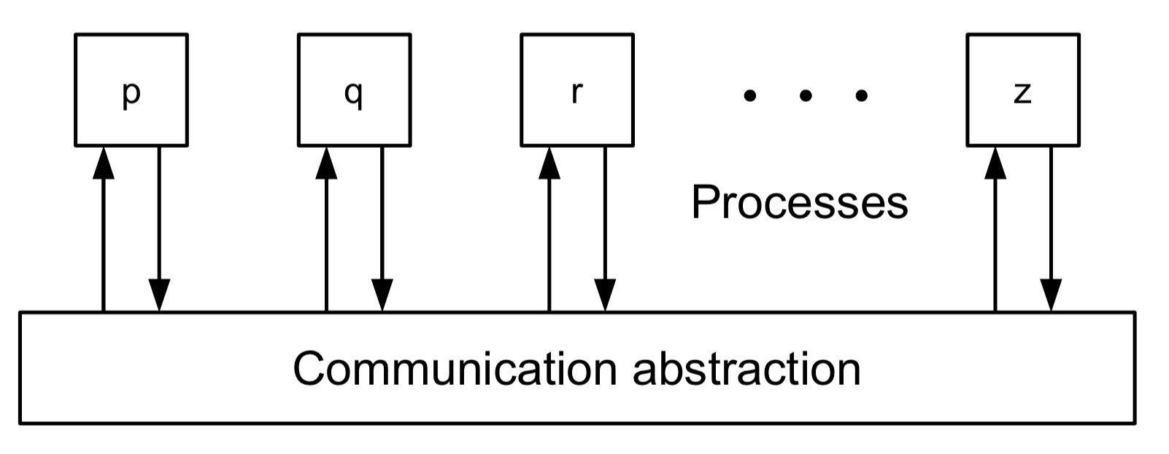
automata and steps
A distributed algorithm consists of a distributed collection of automata, one per process
The automaton at a process regulates the way the process executes its computation steps, i.e., how it reacts to a message
Every process is implemented by the same automaton:
they interact through some means of communication

Slide 9
execution
The execution of a distributed algorithm is represented by a sequence of steps executed by the processes
We speak of:
partial executions
finite number of steps
and infinite executions
infinite number of steps

Slide 10
time and clocks
We will assume the existence of a global clock, outside the control of the processes
Provides a global and linear notion of time that regulates the execution of the algorithms
The steps of the processes are executed according to ticks of the global clock:
one step per clock tick
A correct process executes an infinite number of steps of its automaton

Slide 11
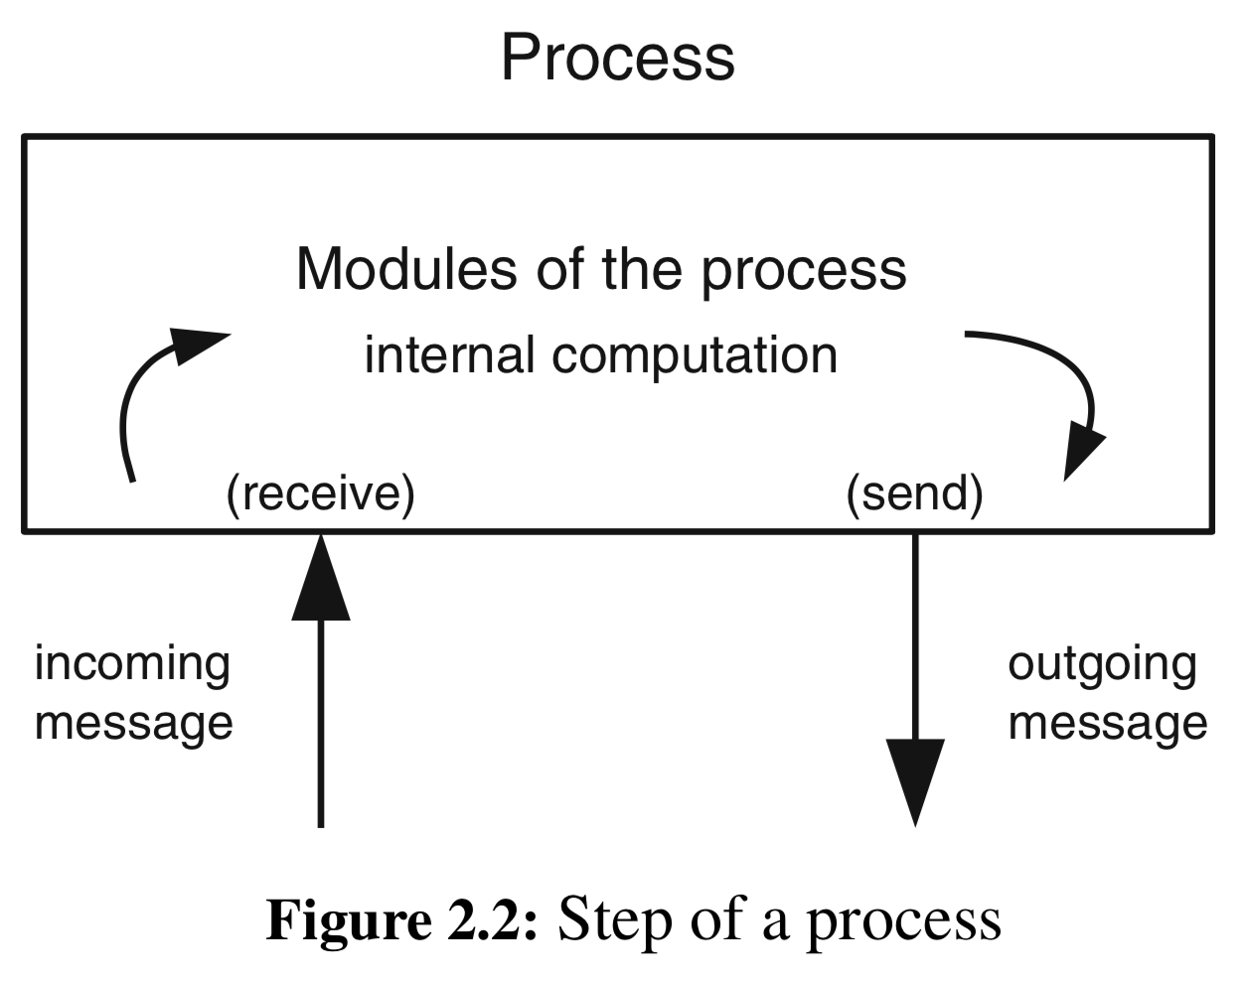
steps
A process step consists of:
Receiving (delivering)
global event
Sending
global event
Executing a local computation
local event
Important:
Interaction between components on a same process is viewed as local computation, NOT communication

Slide 12
steps cont.
There are two primary steps in an automata:
Communication step
when a process sends a message to another process, and the latter receives this message, through events occurring at different processes
Computation step
when an event is exchanged between two modules of the same process
Communication steps are usually MUCH more costly due to typical transmission delays of networks

Slide 13
deterministic algorithms
Our algorithms will be primarily deterministic
every:
step performed by any given process
local computation executed by the process
local state after the computation
message sent by this process
are uniquely determined by the message received by the process and its local state prior to executing the step
We will also consider some randomized solutions

Slide 14
Safety vs. liveness
HUGELY important to understand
We will speak of properties of an algorithm that implement some distributed abstraction
seek to satisfy the properties of the abstraction in all possible executions of the algorithm, covering all possible sequences of steps executed by the processes
The properties fall into two categories:
Safety
Liveness

Slide 15
safety
Informally:
A safety property states that nothing bad should happen in an algorithm run
More formally:
can be violated at some time t and never be satisfied again after that time
An example regarding communication links:
“No process should receive a message unless this message was indeed sent”
There is a time t…
Not enough, could do nothing and be “safe”

Slide 16
liveness
Informally:
Ensures that something good eventually happens
More formally:
a property of a distributed system execution such that, for any time t, there is some hope that the property can be satisfied at some time t′ ≥ t
To show it is violated, must show that in an infinite execution, the property was never met
Example for communication links:
if a correct process sends a message to a correct destination process, then the destination process should eventually deliver the message

Slide 17
providing both
Consider the traffic light:
What are the safety properties?
What are the liveness properties?
Consider coming to class:
“Don’t listen to anyone else other than instructor in class” (safety or liveness?)
“Be awake and alert” (safety or liveness?)

Slide 18
process abstraction
A process executes a distributed algorithm through the set of components implementing the algorithm
Failure
When a process does not behave according to the algorithm
When the process fails, all its components fail at the same time

Slide 19
incentive opportunities
Read paper:
Why do Internet Services Fail, and What Can be Done about It? D. Oppenheimer, A.Ganapathi and D. A. Patterson, 2003.
Write three paragraphs summarizing the paper for 10 points
Read the paper:
Why Do Computers Stop and What Can be Done about It? Jim Gray, 1985.
Write three paragraphs summarizing the paper for 10 points

Slide 20
why do computer systems fail?
1985, Fault-tolerant system (Tandem – [Gray’85])
System administration (operator actions, system configuration and maintenance)
Software faults, environmental failures
Hardware failures (disks and communication controllers)
Power outages
2004, The Internet Age
Operator error (particularly configuration errors) is the leading cause of failures
Failures in custom-written front-end software
Not enough on-line testing

Slide 21
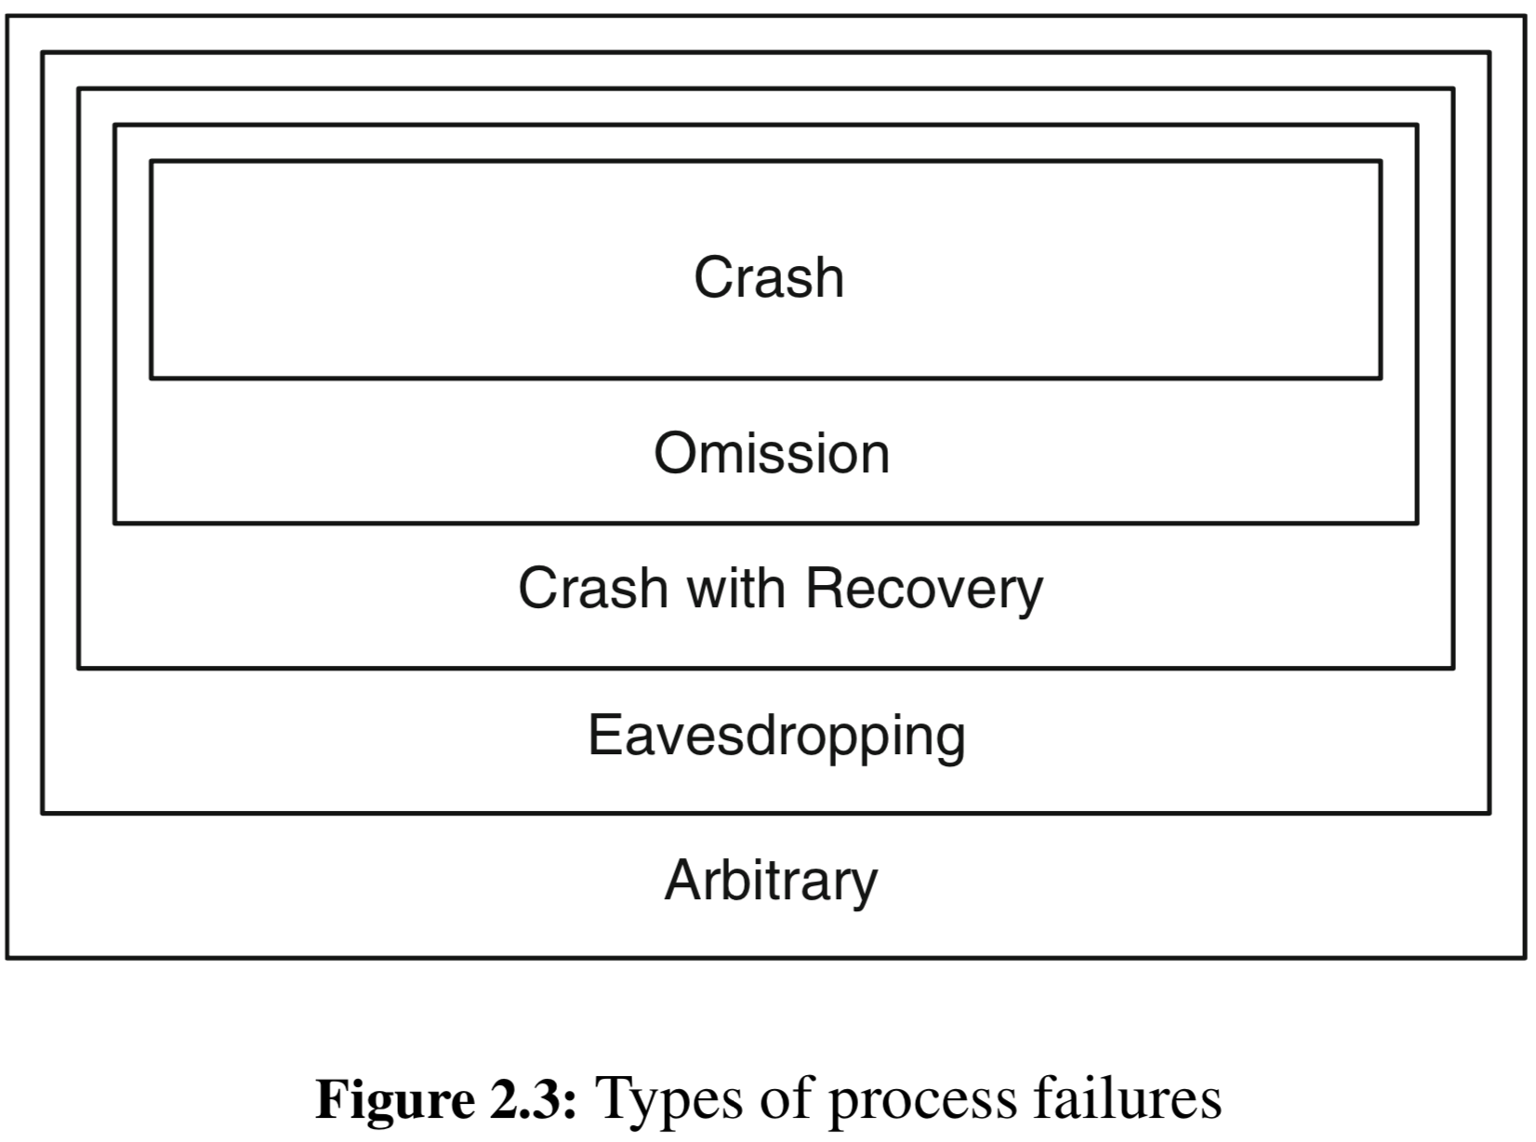
failure types

Slide 22
crashes
When a process simply stops executing steps
executes until some time t, after which does NOT do anything else
We say:
the process crashes at time t and does not recover
Called a crash-fault
leads to crash-stop failure abstraction
the typical abstraction that we will use
A process is said to be correct if it never crashes and executes an infinite number of steps

Slide 23
ramifications
We will discuss algorithms that tolerate up to f faulty processes
Some algorithms tolerate that f be the minority number of processes ($\frac{(N+1)}{2}$ processes must remain correct)
Some algorithms tolerate that f be N - 1
Resilience — The relation between the number f of potentially faulty processes and the total number N of processes in the system
Only in regards to the lifetime of the execution, not “forever”
Notes:
It is also important to notice that, in practice, the crash-stop process abstraction neither precludes the possibility of recovery nor does it mean that recovery should be prevented for a given algorithm

Slide 24
omission failures/faults
Occurs when a process does not send (or receive) a message that it is supposed to send (or receive) according to its algorithm
message loss due to:
buffer overflows
network congestion
Come in flavors:
Send omission
Receive omission
Network transmission failure
Notes:
Not really addressed in the book much

Slide 25
Crashes with recovery
In this model:
We say that a process is faulty if either the process crashes and never recovers or the process keeps infinitely often crashing and recovering
Otherwise, the process is correct
A process that crashes and recovers a finite number of times is correct in this model
Crash-recovery process abstraction
with crash-recovery faults

Slide 26
ramifications
A process can crash and stop to send messages, but might recover later
Could be viewed as a send omission
BUT a process might suffer amnesia when it crashes and lose its internal state
To cope, every process has, in addition to its regular volatile memory, a stable storage (also called a log)
accessed through store and retrieve operations
want to minimize these operations
When recovering, a process “knows it” and automatically executes a special ⟨ Recovery ⟩ event

Slide 27
ramification cont.
What about crash-stop processes that just restart with new process ID?
doesn’t really work, processes are static in the system
Tricky issue:
What if an event occurs and a module sends an indication to another module then crashes?
Did the upper module get the indication?
How to know?
Solution:
Change interface between modules where module stores indication for other modules to retrieve (generally what we do)
Keep delivering event until upper module says “stop”

Slide 28
eavesdropping faults
We often work in an untrusted environment
some of its components of the system may become exposed to an adversary
or even fall under adversarial control
One benign form
when a process leaks information obtained in an algorithm to an outside entity
The outsider may eavesdrop on multiple processes in this way and correlate all leaked pieces of information
threatens the confidentiality of the data handled by an algorithm, such as the privacy of messages

Slide 29
ramifications
Eavesdropping faults do occur in practice
An eavesdropping fault cannot be detected by observing how an affected process behaves in an algorithm
the process continues to perform all actions according to its instructions
The adversary merely reads the internal state of all faulty processes
In practice, however, the eavesdropper must run some code on the physical machine that hosts the faulty process (can usually be detected…)
Eavesdropping faults typically affect communication links before they affect the processes

Slide 30
preventing eavesdropping
In practice, can be prevented by cryptography
encrypt messages and stored data
although confidentiality and privacy are important for many secure distributed programs in practice
they are orthogonal to what we are doing so we will generally not address this type of fault

Slide 31
Arbitrary faults
The worst kind
A process is said to fail in an arbitrary manner if it may deviate in any conceivable way from the algorithm assigned to it
Could be accidental
Could be on purpose
Arbitrary-fault behavior is the most general one
When used, no assumption on the behavior of faulty processes is made
allowed any kind of output and, therefore, can send any kind of message
Such failures are also called Byzantine or malicious failures
Byzantine and arbitrary faulty are synonymous
arbitrary-fault process abstraction or a Byzantine process abstraction

Slide 32
ramifications
The most expensive to tolerate
usually quite difficult
Used when:
unknown or unpredictable faults may occur
the system is vulnerable to attacks
where some of its processes may become controlled by malicious users that deliberately try to prevent correct system operation
Can usually simplify algorithms by:
assuming the existence of one determined adversary that coordinates the actions of all faulty processes

Slide 33
ramifications cont.
When building algorithms for Byzantine processes we “allow” this adversary to
access the messages exchanged over any communication link
to read messages
modify messages
insert messages of its own
In practice, a remote attacker may take over control of the physical machine that hosts the faulty process and:
read the state of a process
completely determine the process’ behavior

Slide 34
ramifications cont.
Arbitrary faults may not be intentionally caused by malicious behavior
Could be bug in
implementation
programming language
compiler
Just causes the process to deviate from the algorithm it was supposed to execute
Can usually be detected
e.g., using cyclic redundancy checks (CRCs)
COMPLETELY ineffective for adversarial type attacks
Protect against maliciousness and you also protect against non-maliciousness
Notes:
we thus consider only arbitrary faults of intentional and malicious nature
The added protection usually relies on cryptographic primitives

Slide 35
cryptographic abstractions
How we deal with Byzantine processes
We will consider three basic cryptographic primitives
Hash-functions (usually very fast)
operation H maps a bit string of arbitrary length to a short, unique representation called an index
no process can find two distinct values x and x′ such that H(x) = H(x′)
Message-authenticated codes (MACs) (also usually very fast)
global “oracle” maintains a set A
authenticates data between two entities using two operations
authenticate — takes sender identifier p, receiver identifier q, and bit string m; returns an authenticator a; places (p, q, m, a) in A
verifyauth — takes identifier q of receiver, p of sender, a bit string m, and a putative authenticator a as parameters; if (p, q, m, a) ∈ A then returns TRUE
Notes:
MACs based on a shared symmetric key which is known only to the sender and to the receiver of a message, but to nobody else

Slide 36
cryptographic abstractions
Digital signatures
provides data authentication in systems with multiple entities that need not share any information beforehand
associating a public key/private key with each entity using two operations:
sign (p, m) — takes a process identifier p and a bit string m as parameters; returns a signature s
verifysig(q, m, s) — takes an identifier q of a process, a bit string m, and a putative signature s as parameters; returns TRUE if and only if process q has previously invoked sign(q, m) and obtained s as response
Digital signatures are more powerful than MACs because they allow messages to be relayed by third parties
even if the third party is untrusted
Digital signatures are based on public-key cryptography (or asymmetric cryptography)
adds significant computational overhead compared to symmetric cryptography

Slide 37
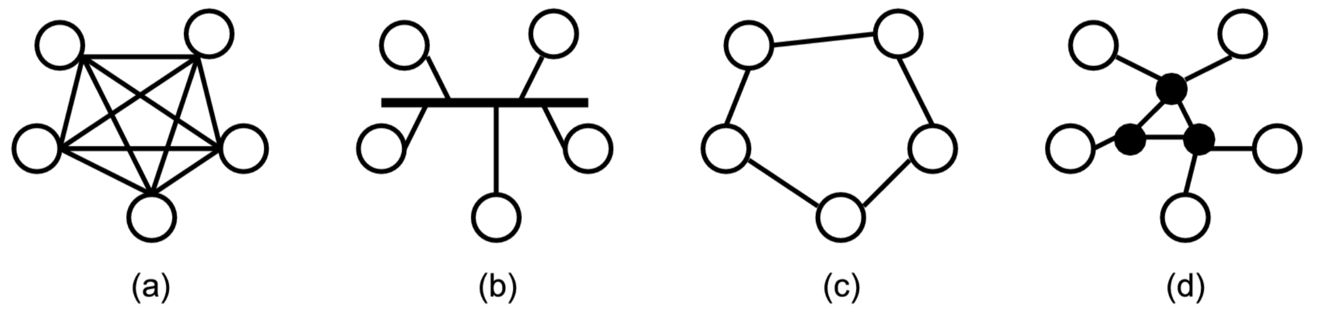
Communication abstraction
The abstraction of a link is used to represent network components
Each pair of processes is connected by a bi-directional communication link
In practice, different topologies may implement this abstraction:

Slide 38
messages
Messages exchanged between processes over a link are unique
receiver can identify the sender using information included with the message
trivial for crash-stop and crash-recover abstractions
for Byzantine (arbitrary-fault) process abstractions, must rely on cryptographic methods to provide correct sender identification
Messages typically carry sequence numbers or timestamps in order to identify correlations
e.g., request/reply type messages

Slide 39
links and link failures
Real-life networks are inherently unreliable
When sending a message, it can be lost with some probability p
Only when a network is partitioned, all messages are lost
otherwise we assume that the probability that a message arrives has a non-zero probability
The Internet Protocol (IP) is considered a “best-effort” service for message delivery and is virtually the ONLY protocol used today
UDP sockets are a bare-bones message-delivery service offered by your OS
TCP sockets, also implemented by your OS, offer reliability on top of unreliable networks
TCP/IP is the standard protocol for computer communication

Slide 40
Reliability
How can we achieve a reliable service (a service that guarantees if a message is sent, it will arrive)?
The standard solution is to keep sending the message until it is confirmed to arrive; typically implemented using:
sequence numbers
acknowledgement (ACK) messages
Messages may be subject to attacks by an adversary who may:
inspect or modify message content
prevent messages from being delivered
requires cryptography

Slide 41
link abstractions
We will consider 5 different link abstractions
Every algorithm we build will use one of these 5 abstractions
The abstraction we “pick” is a factor of:
What kind of faults can occur (crash-stop, arbitrary-faults, etc.)?
What reliability is required for this algorithm?
i.e., can messages be lost and the algorithm still function?
We generally want to choose the abstraction that requires the least amount of overhead and assumptions
All link abstractions are point-to-point link abstractions
i.e., they support communication between pairs of processes
Notes:
We will be looking at broadcast in the next chapter

Slide 42
link implementations
All 5 link abstractions use the same interface (API) but offer different properties
The API uses two different kinds of events:
a ⟨ Send ⟩ request event
a ⟨ Deliver ⟩ indication event
“Receive” vs. “Deliver”
Receive — when a process gets a message from the underlying communication medium
Deliver — when one module “hands off” the received message to a higher module/abstraction, e.g., the application

Slide 43
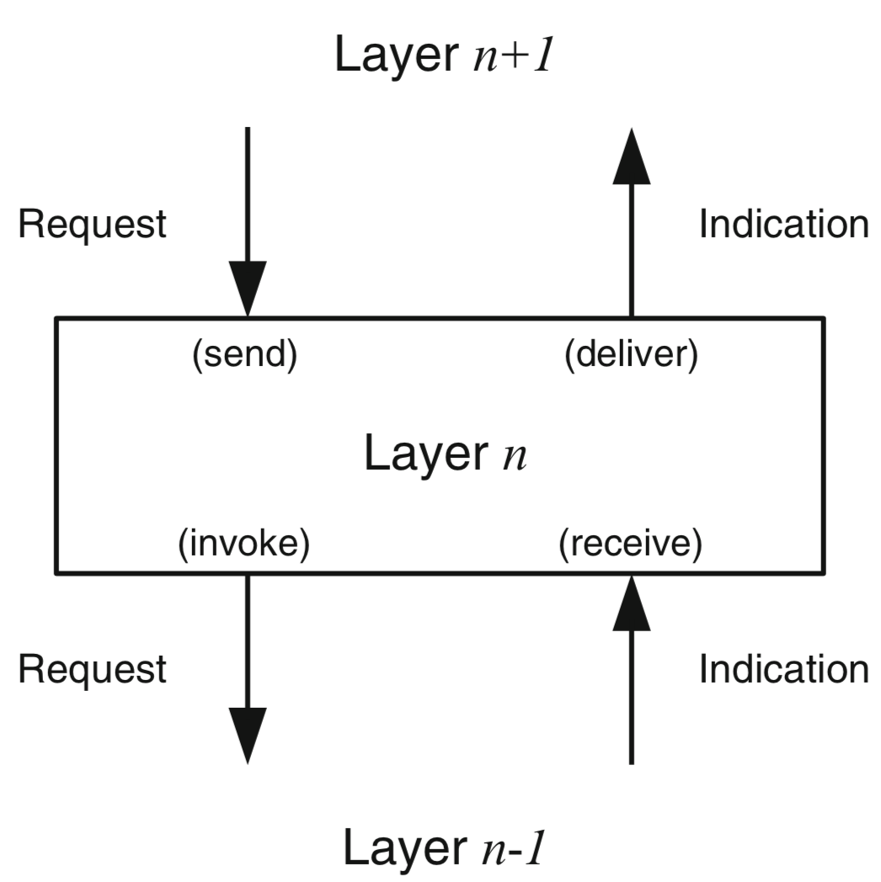
Receive vs. deliver

Slide 44
fair-loss links
The weakest variant of the link abstractions that we will consider
Consists of 2 events:
send — request event to send message
deliver — indication event after message arrives
In practice, this is equivalent to a UDP socket

Slide 45
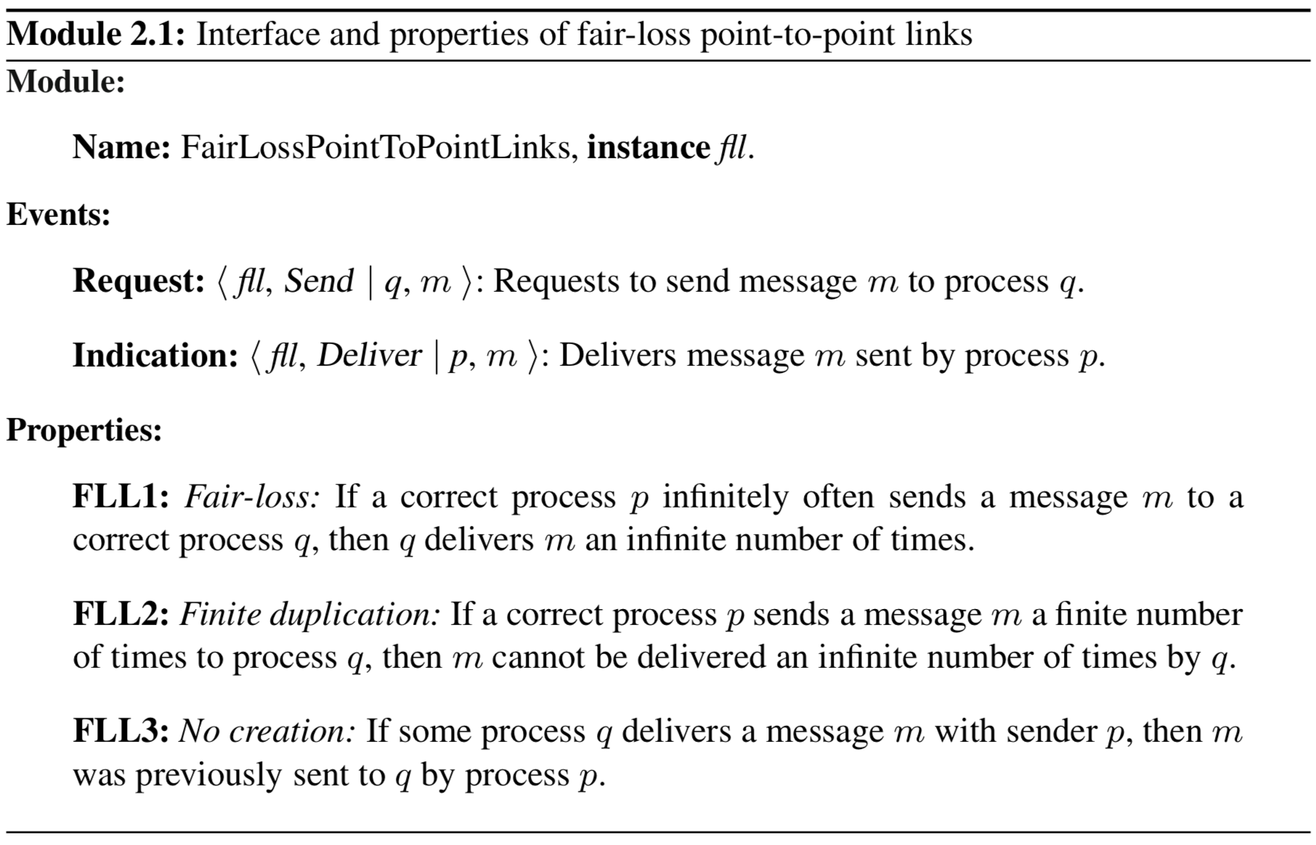
fair-loss links module/interface

Slide 46
Stubborn links
More of a theoretical concept than one used in practice
Provides stronger guarantees than fair-loss links
i.e., as long as there is not a network partition, this guarantees that the message will get to its recipient

Slide 47
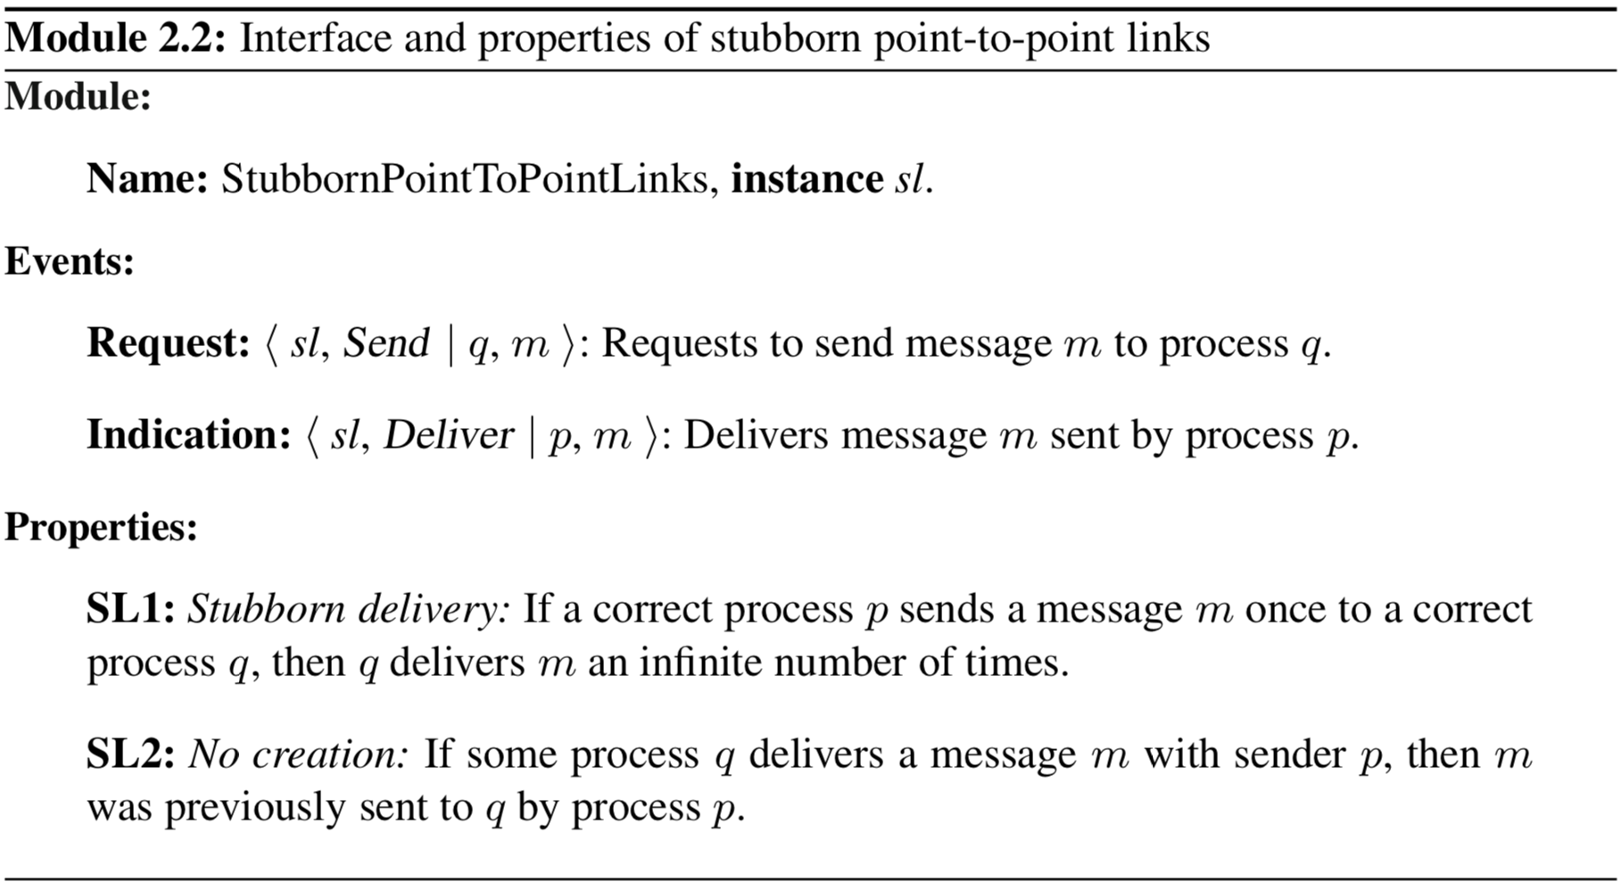
Stubborn links module/interface

Slide 48
algorithm: retransmit forever
Implements stubborn links abstraction
Works on top of fair-loss links (i.e., stubborn links use fair-loss links)
Simple idea:
When asked to send a message, send it repeatedly forever
Uses a local timer that triggers a ⟨ Timeout ⟩ event after a specified delay ∆ when calling starttimer

Slide 49
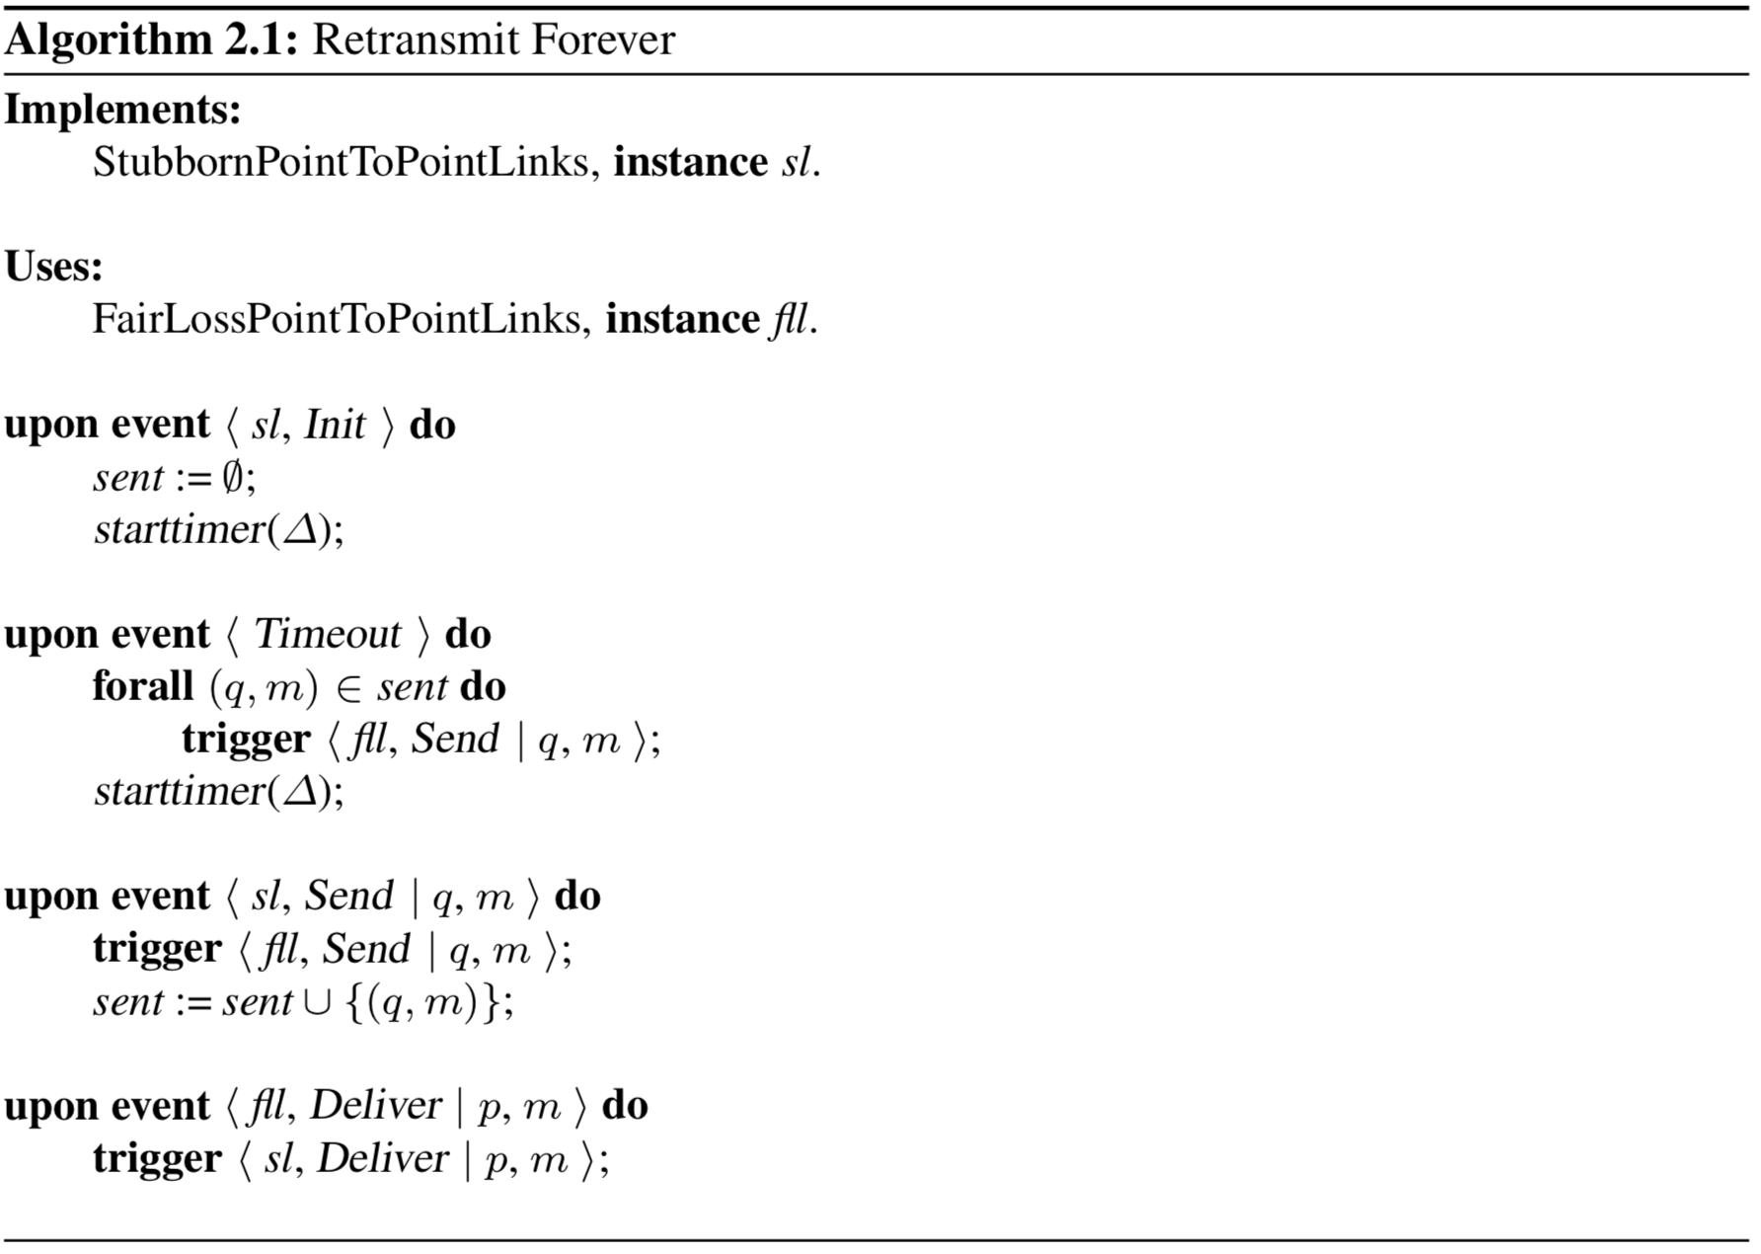
Notes:
Draw layers on board
Properties:
Stubborn delivery
No creation

Slide 50
perfect links
Guarantees if a message is sent, it is delivered by the recipient
Also called reliable links

Slide 51
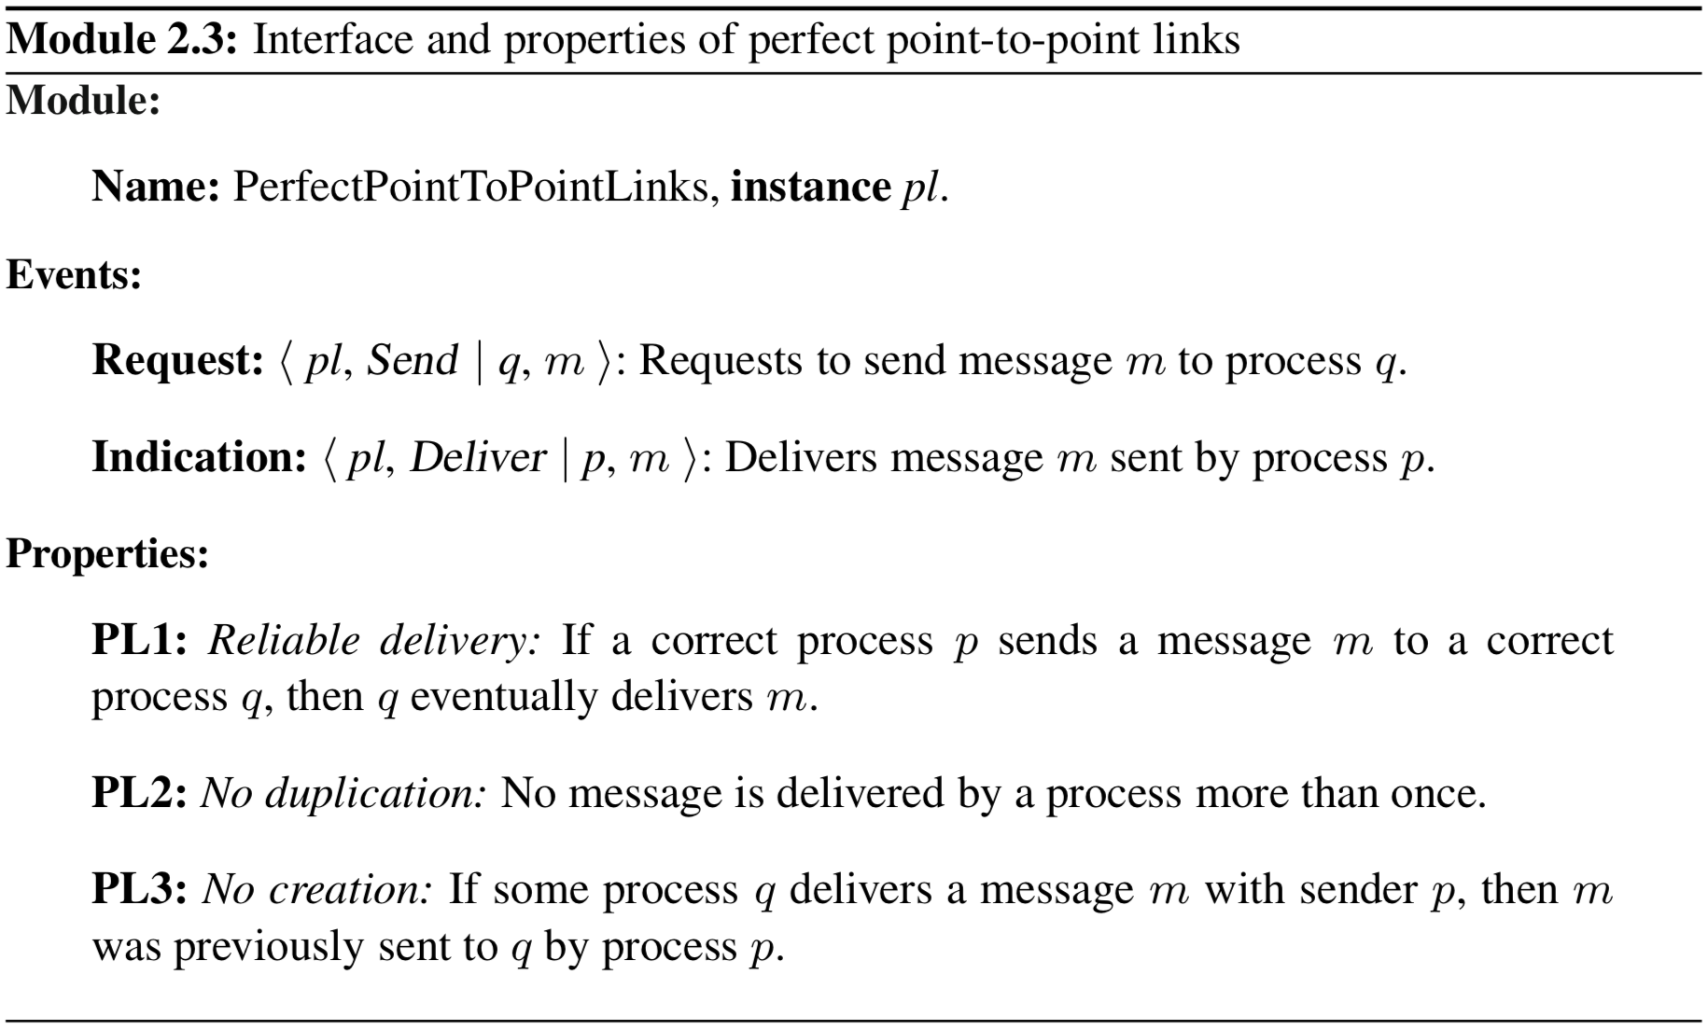
Perfect links module/interface

Slide 52
perfect links implementation
Can be built on top of stubborn links
Simply eliminate duplicates from the underlying stubborn link
tracks messages that have been previously delivered

Slide 53
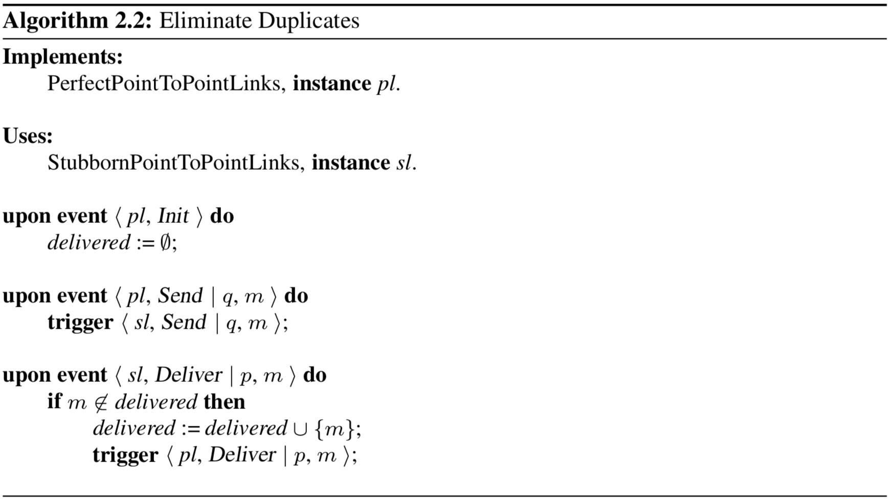
eliminate duplicates algorithm
Notes:
Properties:
Reliable delivery
from stubborn delivery
No duplication
No creation
Using acknowledgements and timestamps, could halt the “send forever” issue

Slide 54
Logged perfect links
Used for the crash-recovery process abstraction
Uses stable storage to track message delivery
Accessed through store and retrieve operations
Interface of all modules is redefined:
To deliver an event to a higher layer
first log the event in stable storage
trigger ⟨ Deliver | identifier ⟩ event where identifier is theme of stable storage variable
Upper layer uses retrieve operation on the variable given by identifier

Slide 55
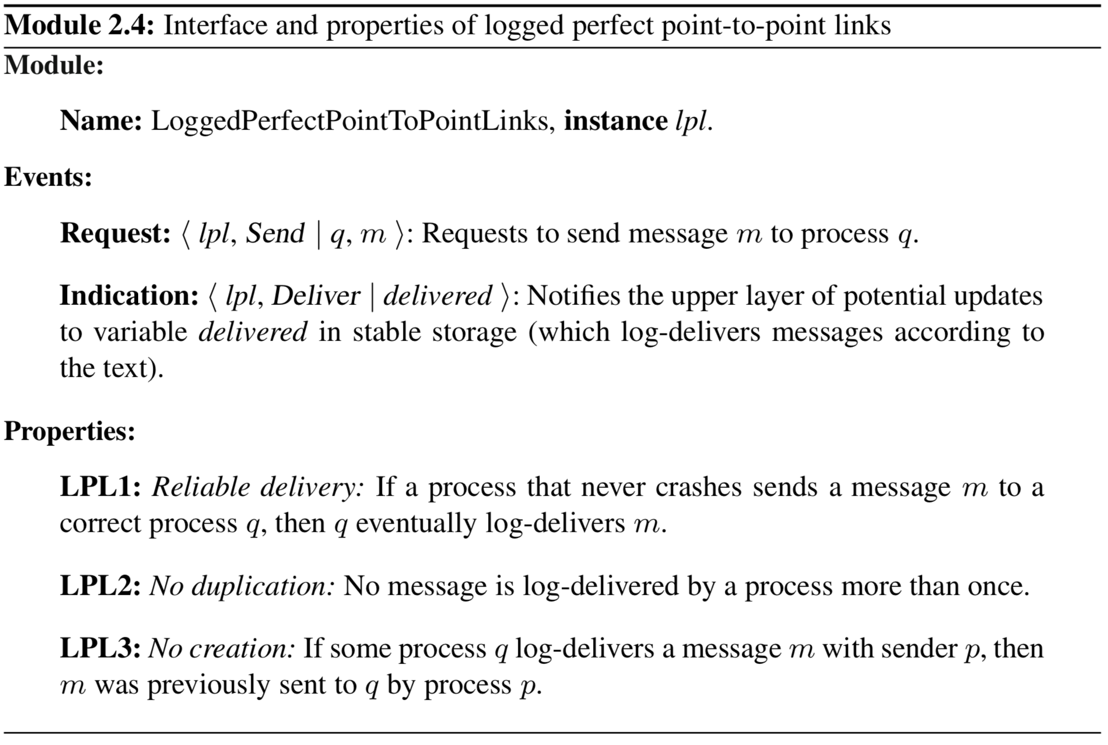
Notes:
Notice in reliable delivery, not if a correct process sends a message but a process that NEVER crashes; in crash-recovery abstraction a correct process is allowed to crash a finite number of times

Slide 56
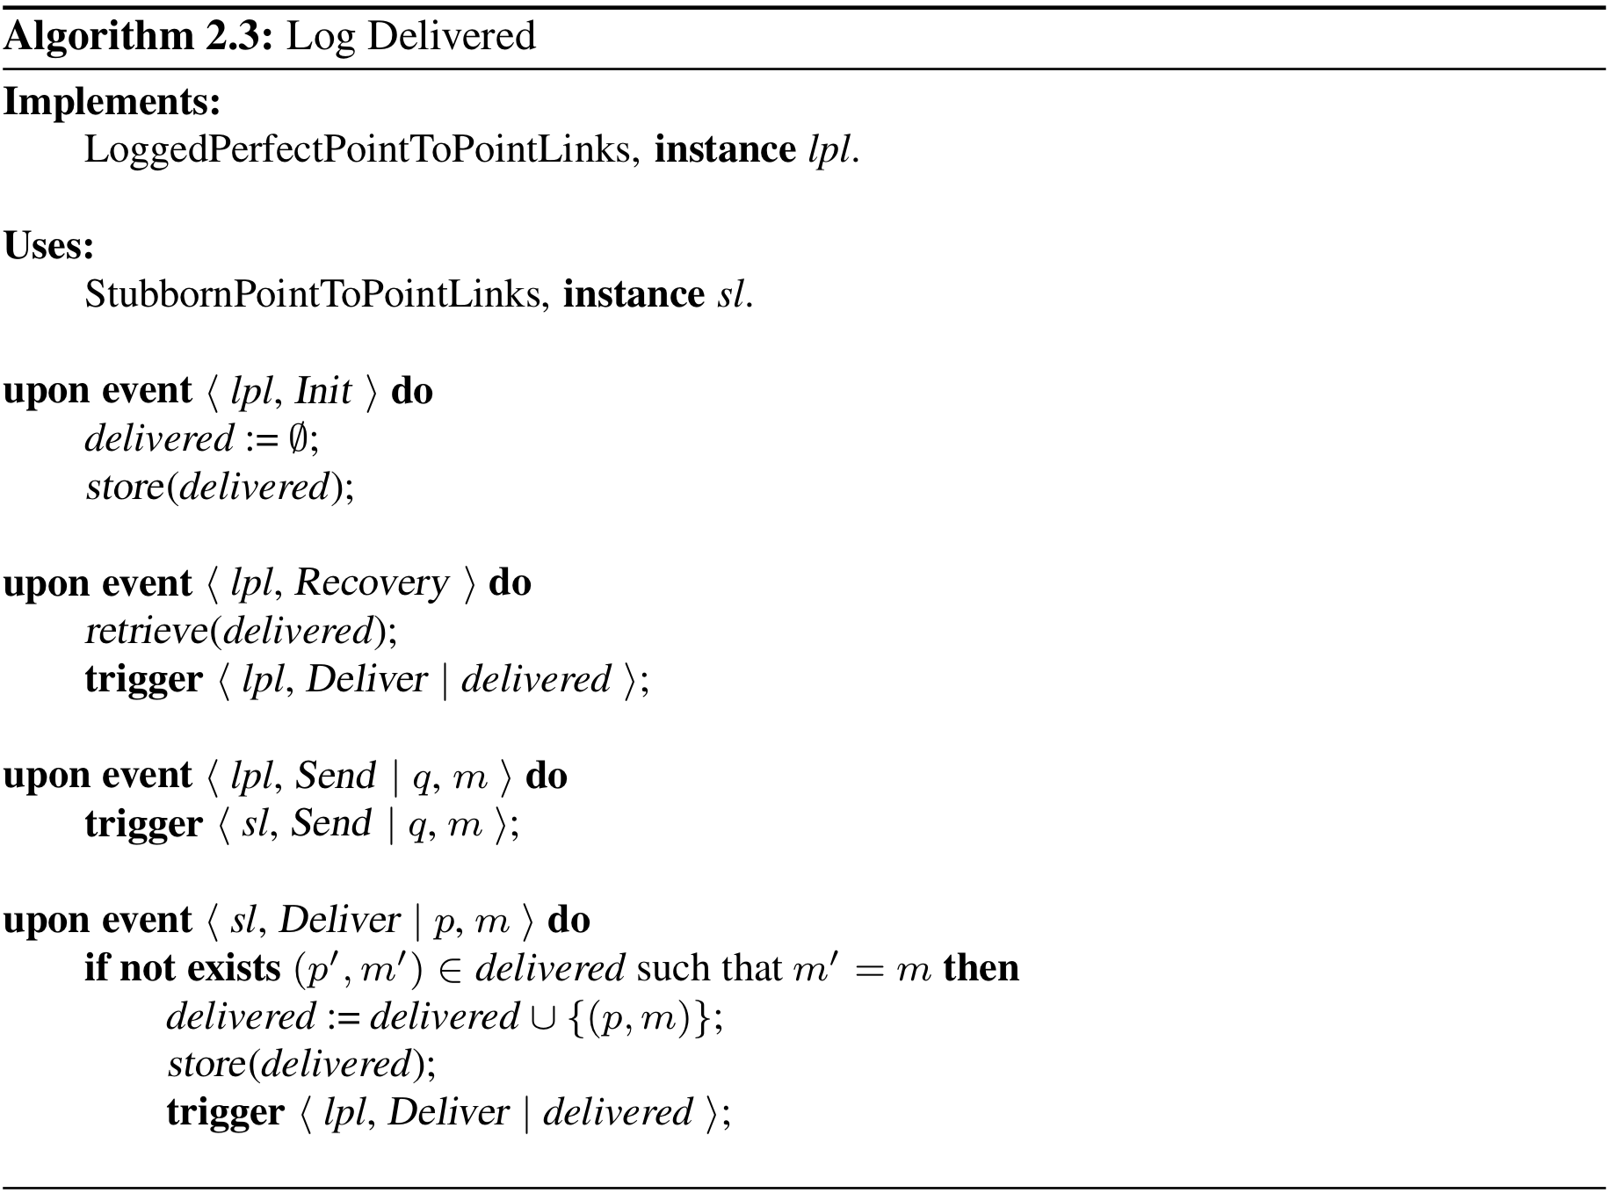
Notes:
Properties:
Reliable delivery
from stubborn delivery of underlying layer
No duplication
No creation

Slide 57
authenticated perfect links
Used for the arbitrary-fault, or Byzantine, process abstraction
While an adversary can eavesdrop and perhaps intercept messages, we assume that it does not intercept all of them
Eliminates the forgery of messages by an adversary by using MAC to authenticate messages

Slide 58
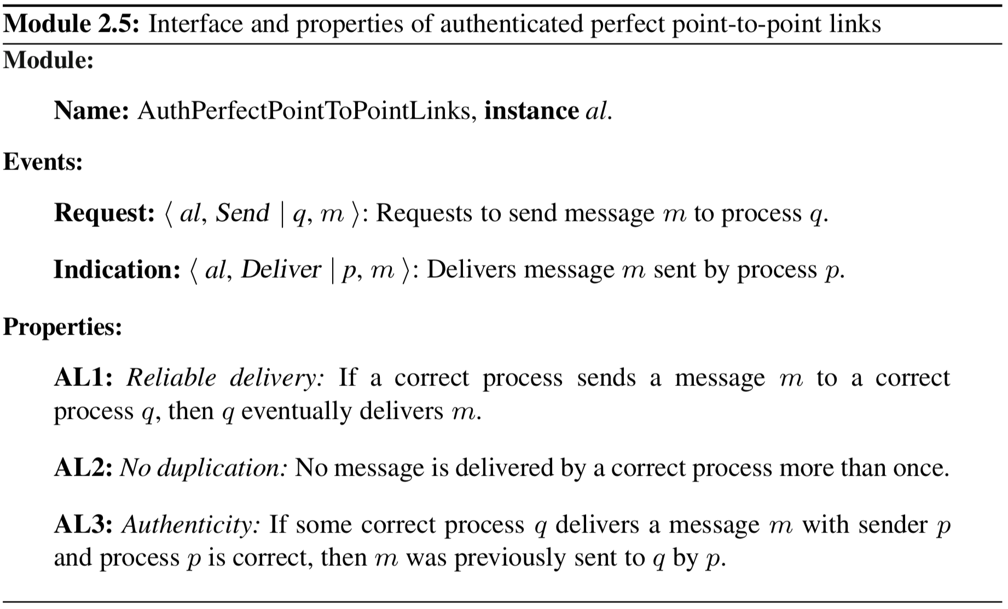

Slide 59
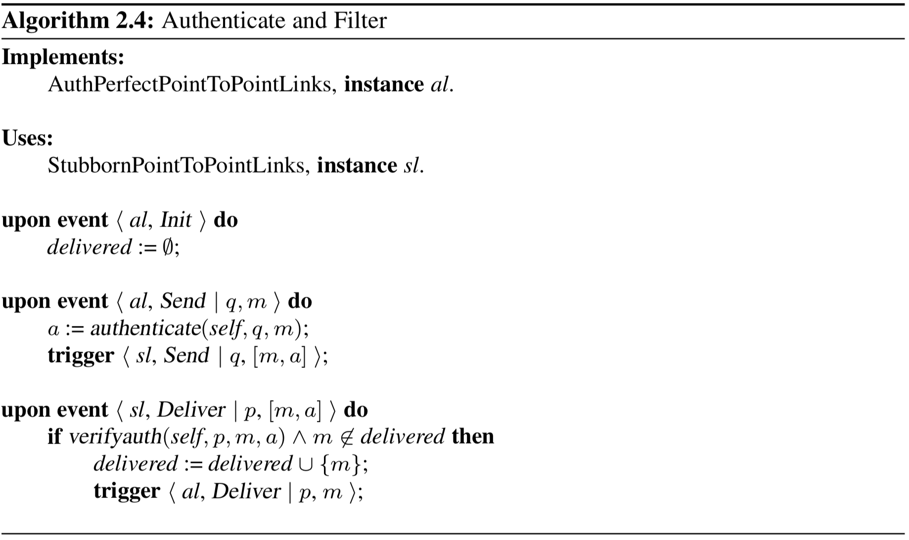
Notes:
Properties: 1) Reliable delivery
A) from stubborn delivery
2) No duplication
3) Authenticity

Slide 60
time
The concept of time is very important in distributed systems
What event “happened before” the other event?
The assumptions we make on the underlying system changes our models
What assumptions can we make on message delivery?
time bounds on speed/propagation delay
What assumptions can we make on processing delay?
There are three different primary timing models we use to make assumptions on the system

Slide 61
Examples of the need for time
Distributed database transaction journaling and logging
Stock market buy and sell orders
Secure document timestamps (with cryptographic certification)
Aviation traffic control and position reporting
Sleep cycles in sensor networks
…

Slide 62
synchronize physical clocks?
External synchronization
Consider the source S and the synchronization bound B > 0, then none of the clocks drift with more than B from S, at any time
Internal synchronization
Consider the synchronization bound B > 0, then at any time, the difference between any two clocks is within B

Slide 63
algorithm for clock synchronization
Cristian’s algorithm
Uses a time server to synchronize clocks
Clients ask the time server for time and adjust their clock based on response
RTT estimated by the client: Tsend - Treceive
Tclient = Tserver + (RTT / 2 )

Slide 64
algorithm for clock synchronization
Berkeley algorithm
Uses elected master to synchronize
The master obtains the local time from all machines, adjusts times received for RTT & latency, averages times, and tells each machine how to adjust
In some systems multiple time servers are used
Time is more accurate, but still drifts

Slide 65
in practice
Synchronize computers across several networks?
NTP (network time protocol) is a protocol designed to synchronize the clocks of computers over a network
NTP version 3 is an internet draft standard, formalized in RFC 1305
NTP version 4 is a significant revision of the NTP standard, current development version
Nominal accuracies of low tens of milliseconds on WANs, sub-milliseconds on LANs, and sub-microseconds using a precision time source such as a cesium oscillator or GPS receiver
Details
www.eecis.udel.edu/~mills/database/brief/overview/overview.ppt

Slide 66
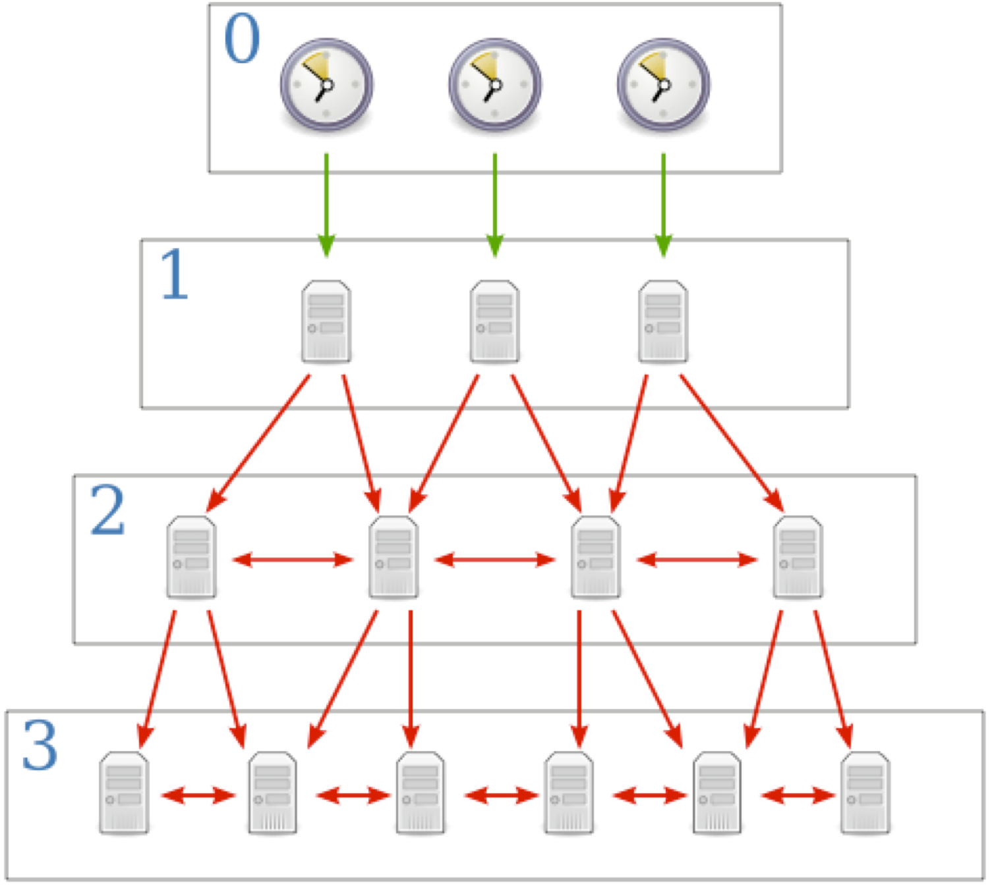

Slide 67
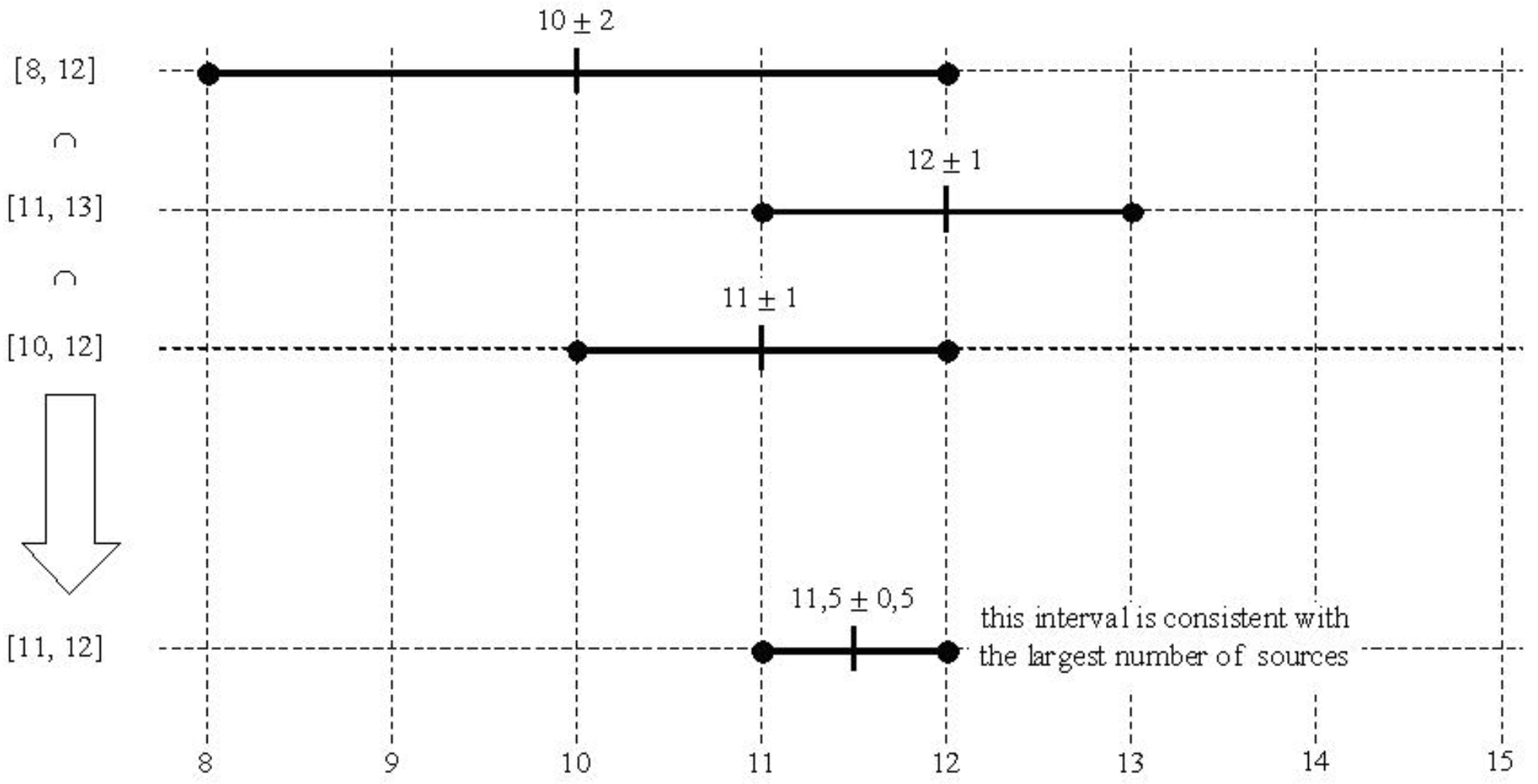
marzullo’s algorithm
Set of clock sources with times ti and precisions di
That is times are ti ± di or [ti - di, ti + di ]
Choose the smallest interval consistent with the largest number of sources
E.g, {10 ± 2, 12 ± 1, 11 ± 1} ({[8,12], [11,13], [10,12]}) Resulting time is [11,12] or 11.5 ± 0.5

Slide 68
timing models
Asynchronous systems
Synchronous systems
Partially synchronous systems

Slide 69
asynchronous systems
Absolutely no assumptions made on timing of underlying system
No process has access to some globally synchronous physical clock
time measured through transmission and delivery of messages
called logical time using a logical clock
also called Lamport Clocks
No assumptions on time bounds of communication or processor delays

Slide 70
logical time in asynchronous systems
Each process p keeps an integer called logical clock lp, initially 0
When an event occurs at process p, the logical clock lp is incremented by one unit
When process p sends a message:
add timestamp to message with value of lp at that the moment of sending the message
The timestamp of an event e is denoted by t(e)
When process p receives a message m with timestamp tm, p increments lp using:
lp := max{lp,tm} + 1

Slide 71
logical clocks
Captures cause–effect relations in systems where the processes can only interact through message exchanges
We say event e1 may have potentially caused another event e2, denoted as e1 → e2, when one of the following conditions apply
e1 and e2 occurred at the same process p and e1 occurred before e2
e1 corresponds to the transmission of a message m at a process p and e2 to the reception of m at some other process q
there exists some event e′, such that e1 → e′ and e′ → e2

Slide 72
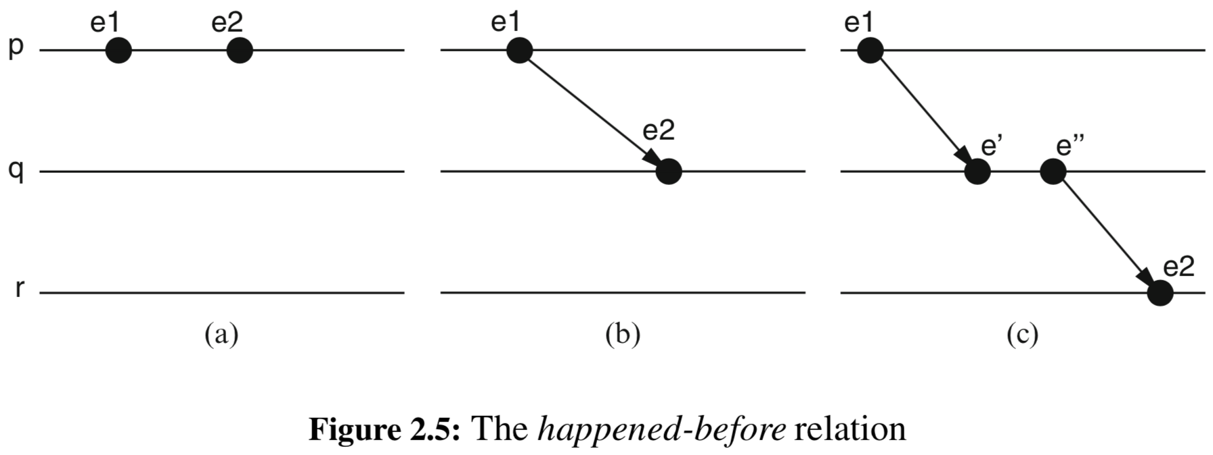
happens before relation
if events are timestamped with logical clocks then
e1 → e2 ⇒ t(e1) < t(e2)
The reverse is NOT true

Slide 73
Concurrent events
Concurrent events a and b are concurrent if neither causally influences the other
Logical clocks assign order to events that are causally independent, in other words events that are causally independent appear as if they happened in a certain order
a → b implies C(a) < C(b)
C(a) < C(b) implies ¬ b → a
C(a) < C(b) does not imply a → b !!!
We need higher resilience

Slide 74
vector clocks
Each process maintains vector Vi initially [0, 0, ...]
When pi executes an event, it increments Vi [ i ]
When pi does send(m) to pj, m piggybacks Vi
When pi does receive(m) from pk
Vi [i] = Vi [i] + 1
Vi = sup(Vi , m.V),
where sup(V1, V2 ) = V s.t. ∀ j: 1 ≤ j ≤ n, V[j] = max(V1 [j], V2 [j])

Slide 75
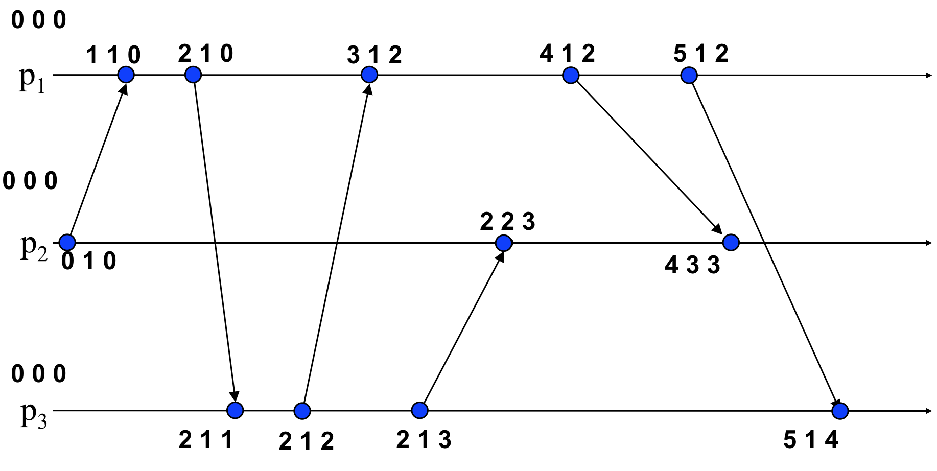
vector clocks example

Slide 76
ordering with vector clocks
VC(x) denotes the vector clock of event x, and VC(x)z denotes the component of that clock for process z
$$VC(X)<VC(y)⟺∀z[VC(x)_{z}≤VC(y)_{z}]∧$$
$∃z^{′}[VC(x)_{z^{′}}<VC(y)_{z^{′}}]$
In English, VC(x) is less than VC(y), if and only if VC(x)z is less than or equal to VC(y)z for all process indices z, and at least one of those relationships is strictly smaller (that is,VC(x)z’ < VC(y)z’)
It is asymmetric and transitive

Slide 77
some papers (i.e., some incentive opportunities)
Time, Clocks, and The Ordering of Events in Distributed Systems. L. Lamport, CACM 27(7): 558-565, 1978.
Virtual Time and Global States of Distributed Systems, F. Mattern, WDPA’89.

Slide 78
other clocks exist…
Matrix clocks
Plausible clocks
Hierarchical clocks
…

Slide 79
synchronous systems
Assumes the following:
Synchronous computation
There is a known upper bound on processing delays
Synchronous communication
There is a known upper bound on message transmission delays
OR
Synchronous physical clocks
Every process is equipped with a local physical clock
There is a known upper bound on the rate at which the local physical clock deviates from a global real-time clock

Slide 80
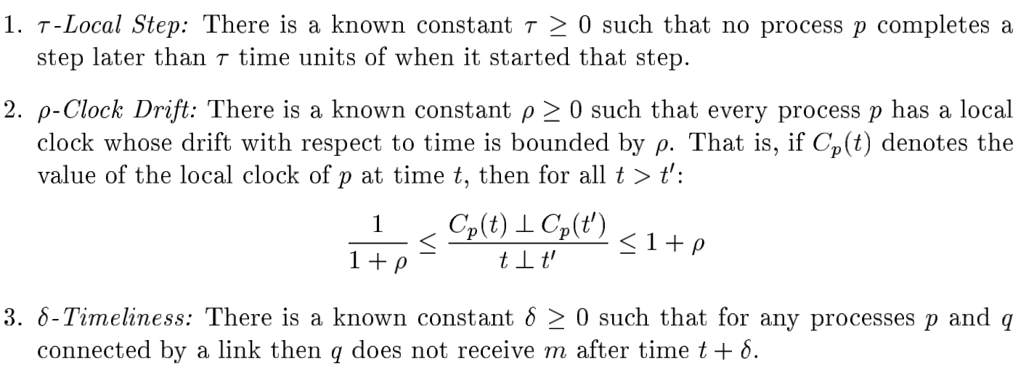
More formally
—
—
(Modular paper has typo, uses “$⊥$” instead of “—“)

Slide 81
implications of a synchronous system
Timed failure detection
Every crash of a process may be detected within bounded time
Can be achieved using heartbeats
Measure of transit delays
Possible to get a good approximation of the delays of messages
can then infer which nodes are more distant or connected by slower or overloaded links
Coordination based on time
can implement a lease abstraction that provides the right to execute some action during a fixed time period, e.g., a file

Slide 82
implications of a synchronous system cont.
Worst-case performance
By assuming a bound on the number of faults and on the load of the system, it is possible to derive worst-case response times for any given algorithm
allows a process to know when a message is received after it is sent
Synchronized clocks
possible to synchronize the clocks of the different processes so that they are never apart by more than some known constant δ
called the clock synchronization precision
allows for synchronized global steps
using timestamps can order all events in the system
Notes:
In practice, δ is always greater than zero and events within δ cannot be ordered.

Slide 83
assuming a synchronous system
Limitation becomes the coverage of the model
Typically requires careful analysis of the network and processing load and the use of appropriate processor and network scheduling algorithms
Feasible for LANs
but NOT for large-scale systems such as the Internet
For Internet, some delays can be large
if assuming a bound, must assume large enough bound to cover all cases making application too slow

Slide 84
partially synchronous systems
For most systems, it is relatively easy to define physical time bounds that are respected most of the time
There are periods, however, where time bounds do not hold
Could be network is congested/overloaded
Could be that a processes memory usage is thrashed temporarily
Messages could get lost messing up delay bounds
Practical systems are thus partially synchronous
We assume that the timing assumptions only hold eventually, without stating when exactly
There is a time after which these assumptions hold forever, but this time is not known

Slide 85
partially synchronous systems cont.
In practice, does NOT mean:
There is a time after which the system is synchronous forever
The system starts in an asynchronous state and later become synchronous
Simply means that system may not always be synchronous, and there is no bound on the period during which it is asynchronous
We DO expect that there ARE periods of synchrony though and they are long enough to actually do something

Slide 86
abstracting time
Our abstractions so far have assumed asynchronous systems
How to add timing assumptions to make synchronous or partially synchronous system?
Could extend/augment the process and link abstractions with timing guarantees/assumptions
Use failure detector abstraction

Slide 87
failure detectors
Provides information about which processes have crashed and which are correct
not necessarily always accurate
We’ll consider failure detectors that encapsulate the timing assumptions of
synchronous systems
more accurate
partially synchronous systems
less accurate
Do not need explicit reference to physical time
Timing assumptions ONLY used for failure detection

Slide 88
some issues
For crash-stop faults, failure detectors work well
But for Byzantine processes, not so easy
Malicious users can make a faulty process look not faulty until just the right moment
Thus, difficult to detect faulty processes in practice in this model
We will not consider a failure detector for Byzantine processes
We will look at leader election for Byzantine processes

Slide 89
perfect failure detector
Denoted by Ρ
In synchronous systems, under the crash-stop process abstraction:
can detect crashes using timeouts
after sending a message, a reply is guaranteed to arrive within a time period equal to
worst-case processing delay + 2 times worst-case message transmission delay (ignoring the clock drifts)
After sending message, if no reply in that time, assume the process has crashed

Slide 90
perfect failure detector
Ρ outputs, at every process, the identities of the processes that it detects to have crashed
we simply say that it detects a process
triggers an event ⟨ Crash | p ⟩
Never changes its mind (detections are permanent)
i.e., if process p detects q, then q remains detected by p forever
Eventually detects all crashed processes and never detects a non-crashed process

Slide 91
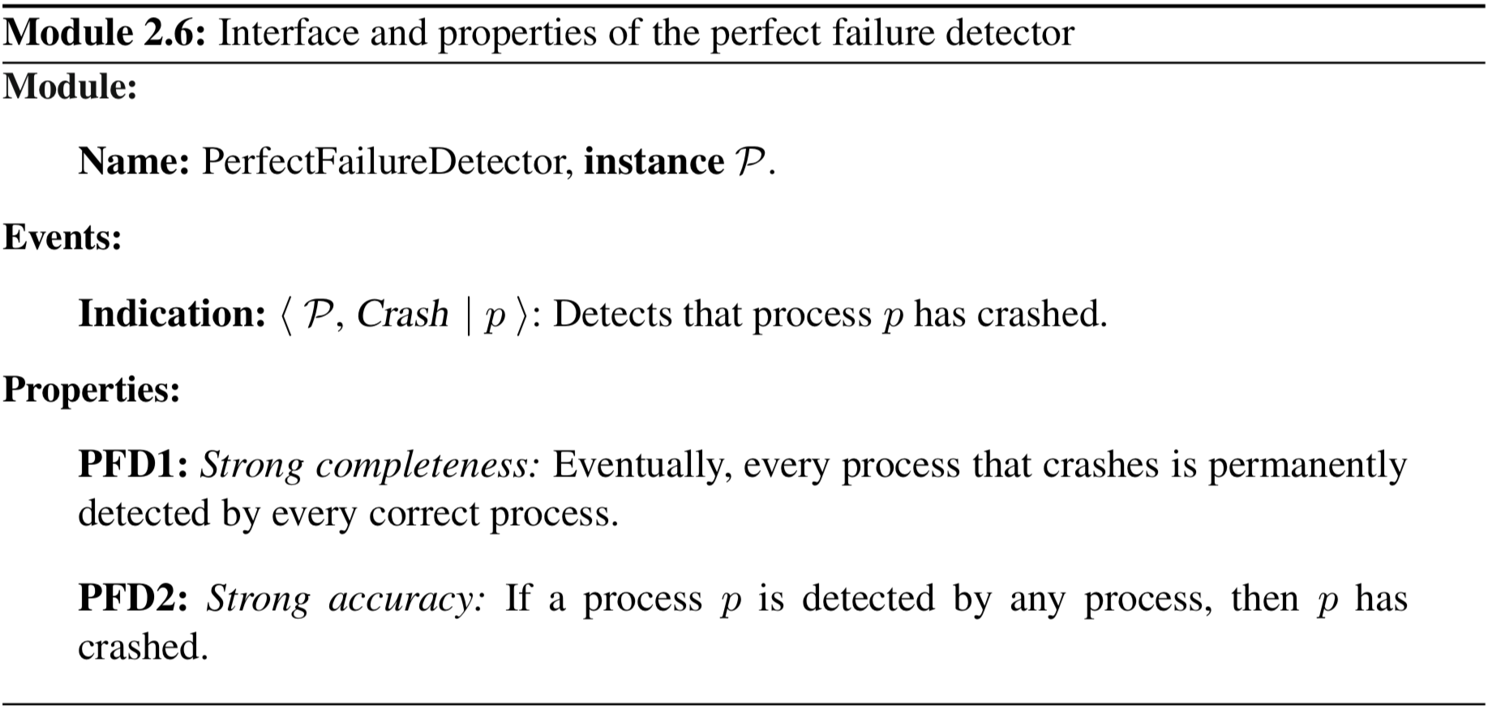
perfect failure detector

Slide 92
perfect failure detector algorithm
Assumes a synchronous system
The perfect communication links do not lose messages sent among correct processes
The transmission period of every message is bounded by some known constant
Exchanges heartbeat messages among all processes and uses a specific timeout mechanism initialized with a delay ∆
large enough so that all processes have time to respond to heartbeat message

Slide 93
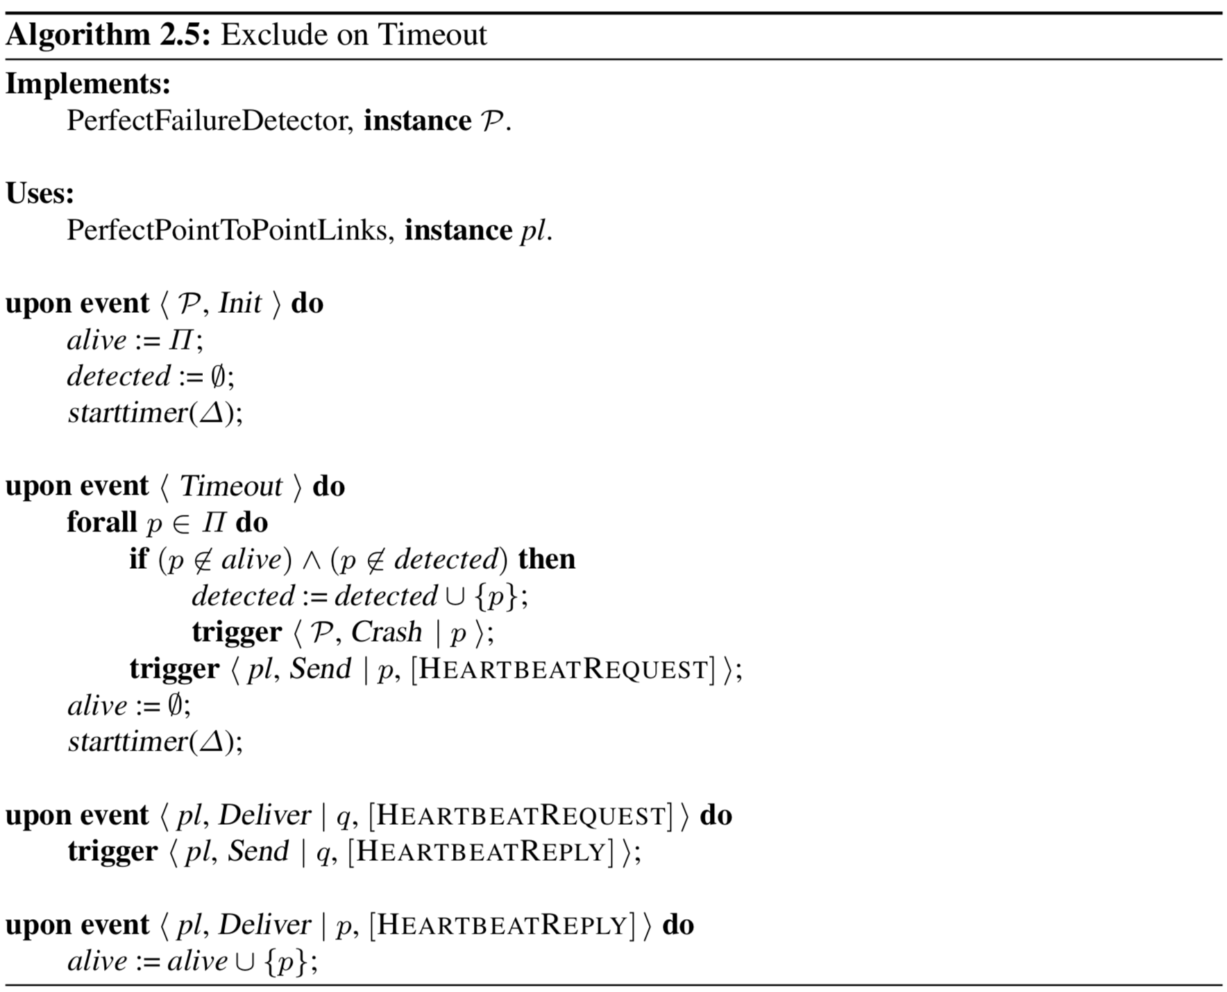
Notes:
Properties:
PFD1: Strong completeness: Eventually, every process that crashes is permanently detected by every correct process.
PFD2: Strong accuracy: If a process p is detected by any process, then p has crashed.

Slide 94
leader election
Maybe we don’t need to detect which processes have crashed
Rather, we want to identify one process that has NOT crashed
This process can act as a leader in some algorithms
We say the leader is trusted by the other processes
Can easily build one using a perfect failure detector
only for crash-stop process abstractions
cannot be formulated for crash-recovery and arbitrary-fault process abstractions

Slide 95
leader election
Chooses one process to be selected as a unique representative of the group of processes in the system
If current leader crashes, a new one should be selected
Particularly useful in a primary-backup replication scheme
a set of replica processes coordinate their activities to provide the illusion of a unique highly available service that tolerates faults of some processes
one replica chosen as leader, sometimes called primary
primary treats requests submitted by clients on behalf of all replicas
before returning reply to client, update the other replicas called backups

Slide 96
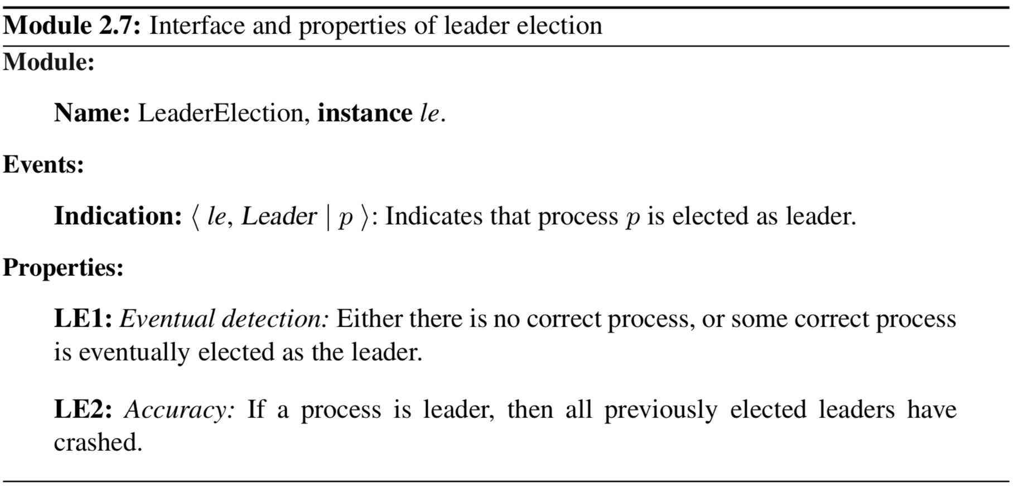
leader election
Notes:
Accuracy property precludes the possibility for two processes to be leader at the same time

Slide 97
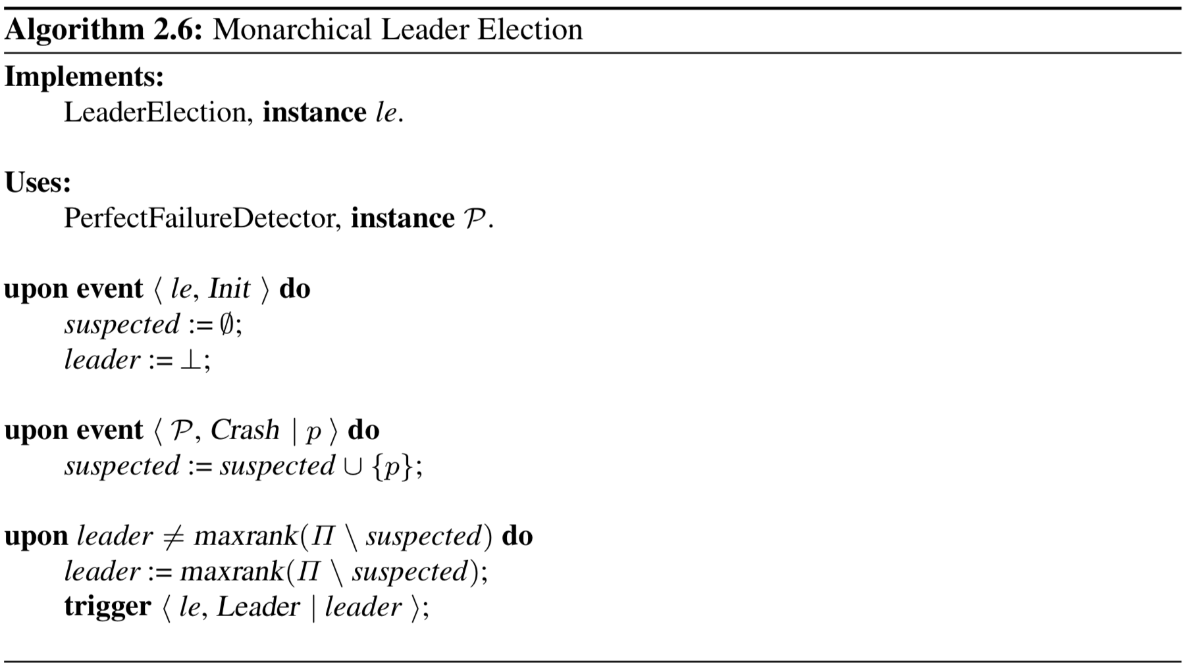
Leader election algorithm
Notes:
LE1: Eventual detection: Either there is no correct process, or some correct process is eventually elected as the leader.
LE2: Accuracy: If a process is leader, then all previously elected leaders have crashed.

Slide 98
eventually perfect failure detector
Denoted as $⋄P$
For partially synchronous systems
Detects crashes accurately after some a priori unknown point in time
makes mistakes until that time
There are periods where the asynchrony of the underlying system prevents failure detection to be accurate and leads to false suspicions
We say a process is suspected rather than detected

Slide 99
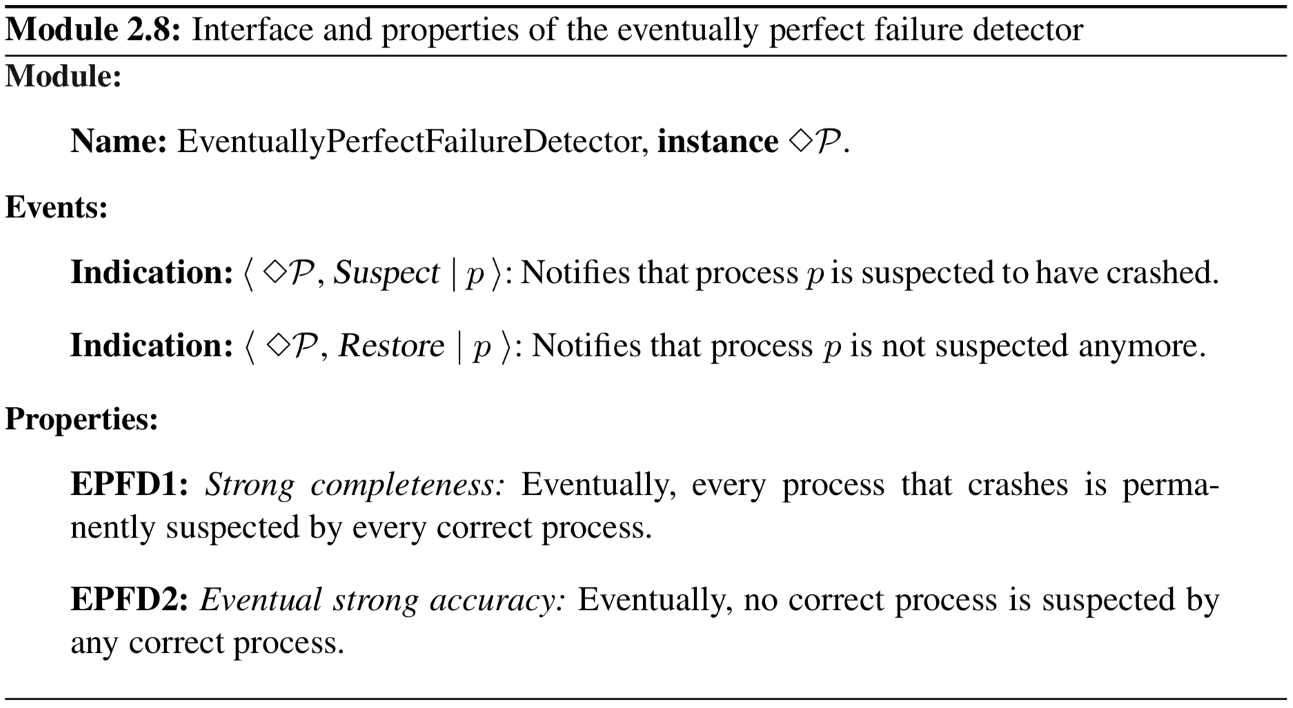
Eventually perfect failure detector

Slide 100
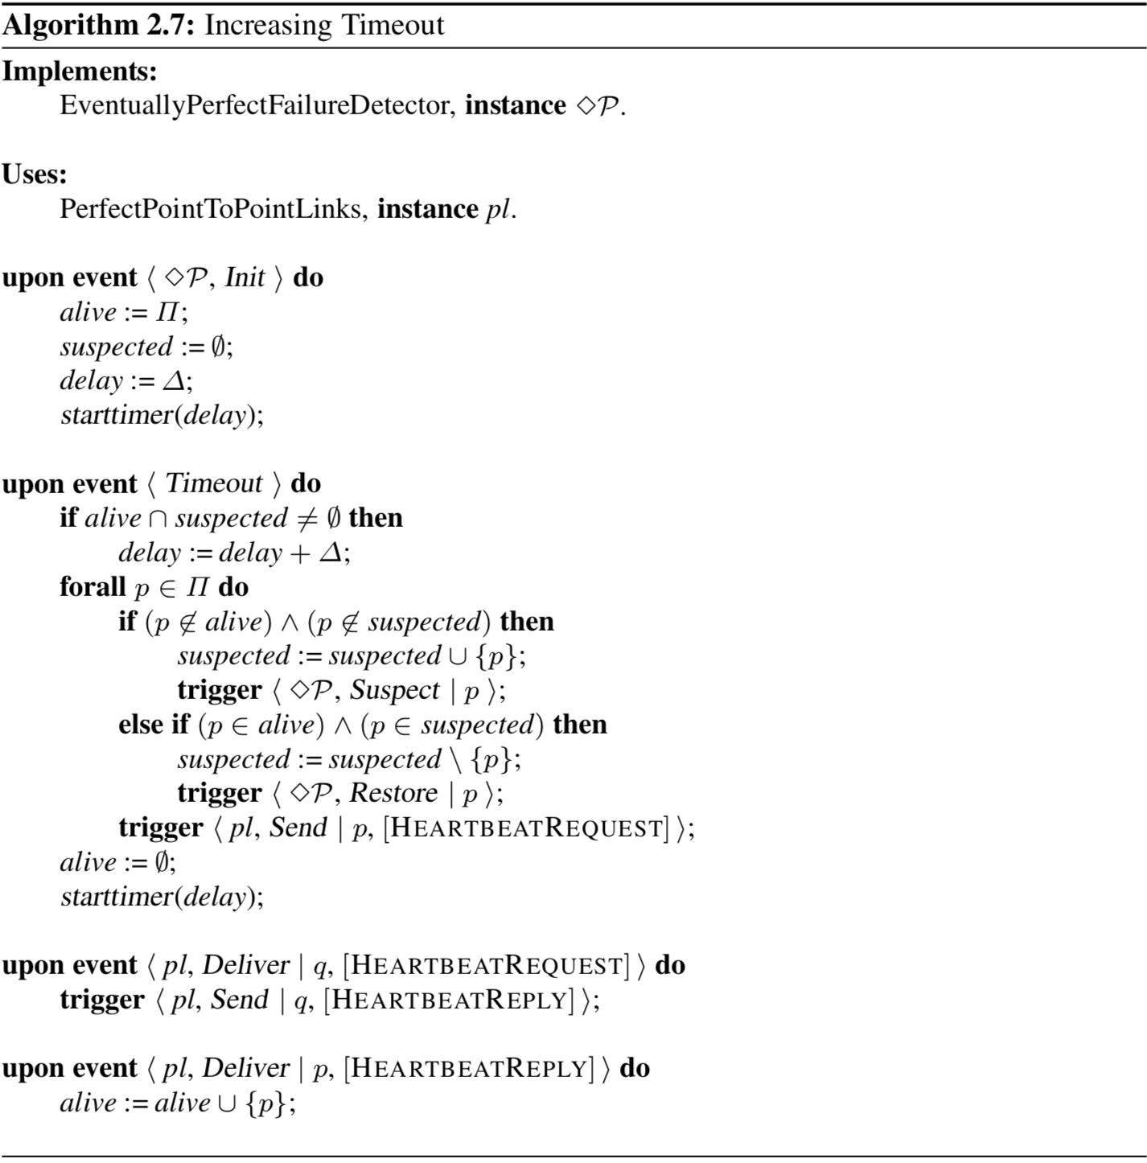
Notes:
EPFD1: Strong completeness: Eventually, every process that crashes is perma- nently suspected by every correct process.
EPFD2: Eventual strong accuracy: Eventually, no correct process is suspected by any correct process.

Slide 101
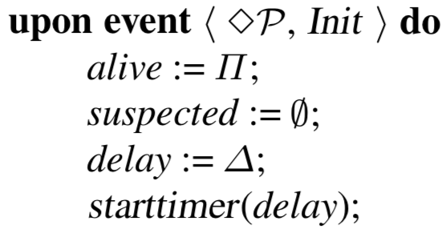
Notes:
EPFD1: Strong completeness: Eventually, every process that crashes is perma- nently suspected by every correct process.
EPFD2: Eventual strong accuracy: Eventually, no correct process is suspected by any correct process.

Slide 102
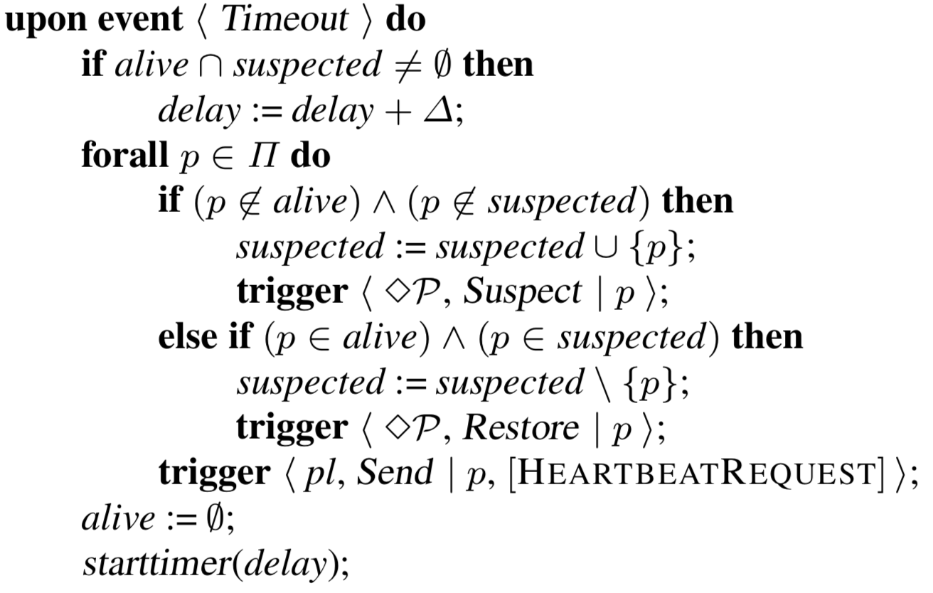
Notes:
EPFD1: Strong completeness: Eventually, every process that crashes is perma- nently suspected by every correct process.
EPFD2: Eventual strong accuracy: Eventually, no correct process is suspected by any correct process.

Slide 103
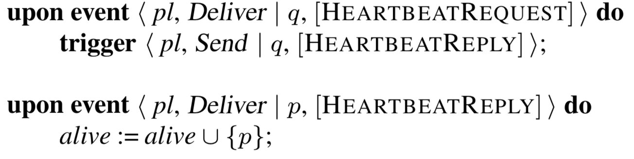
Notes:
EPFD1: Strong completeness: Eventually, every process that crashes is perma- nently suspected by every correct process.
EPFD2: Eventual strong accuracy: Eventually, no correct process is suspected by any correct process.

Slide 104
eventual leader election
Denoted by Ω
Ensures the uniqueness of the leader eventually

Slide 105
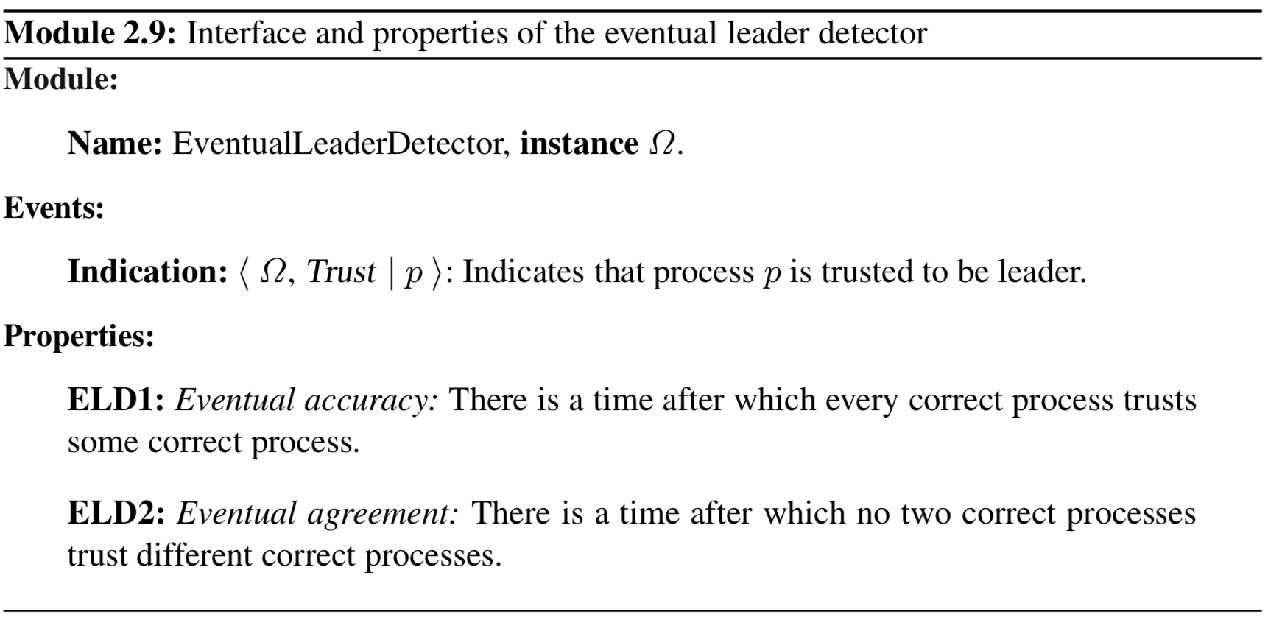
eventual leader election

Slide 106
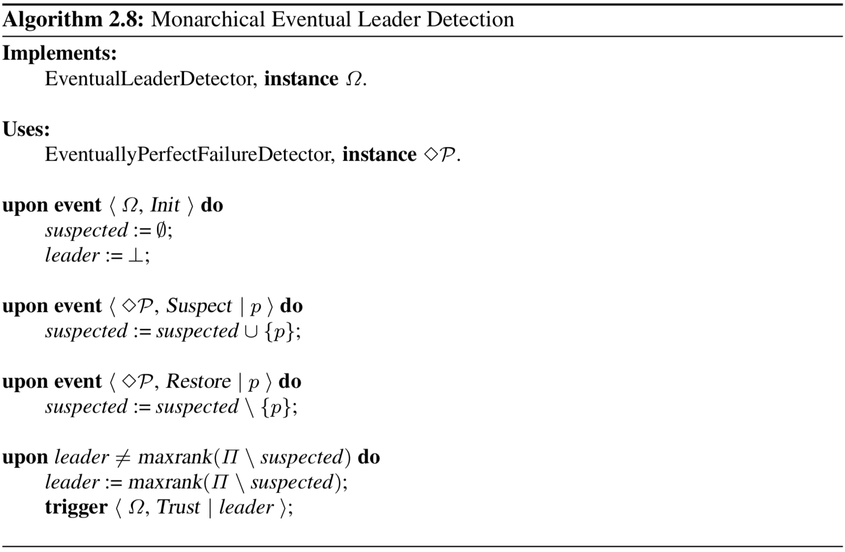
Notes:
ELD1: Eventual accuracy: There is a time after which every correct process trusts some correct process.
follows from the strong completeness property of {diamond} P
ELD2: Eventual agreement: There is a time after which no two correct processes trust different correct processes.

Slide 107
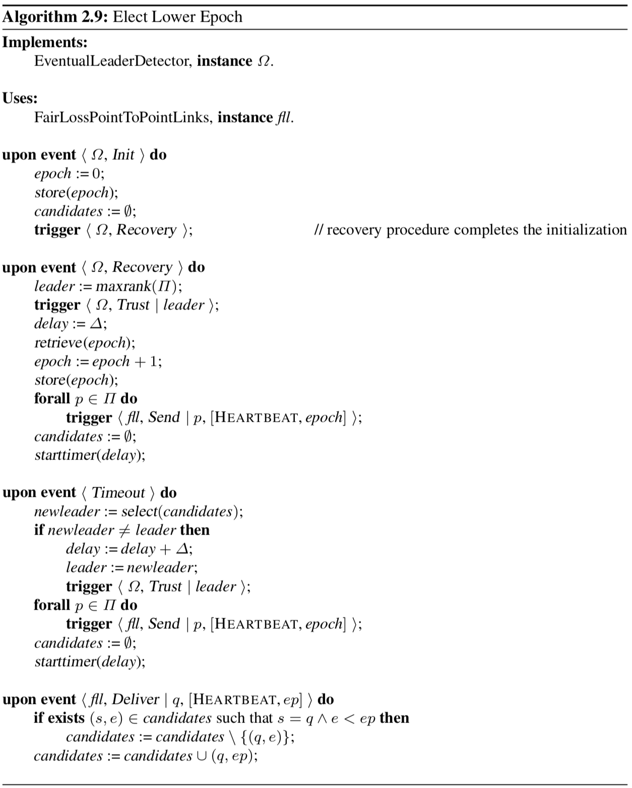
Notes:
ELD1: Eventual accuracy: There is a time after which every correct process trusts some correct process.
ELD2: Eventual agreement: There is a time after which no two correct processes trust different correct processes.

Slide 108
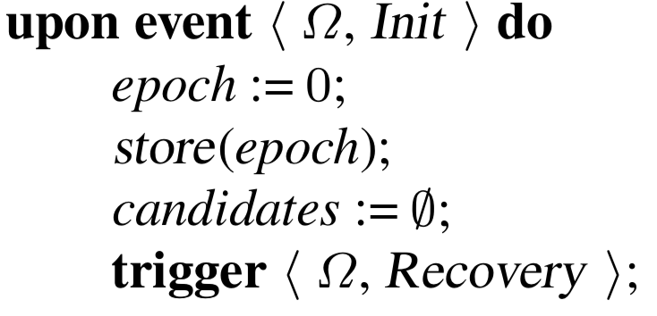
Notes:
ELD1: Eventual accuracy: There is a time after which every correct process trusts some correct process.
ELD2: Eventual agreement: There is a time after which no two correct processes trust different correct processes.

Slide 109
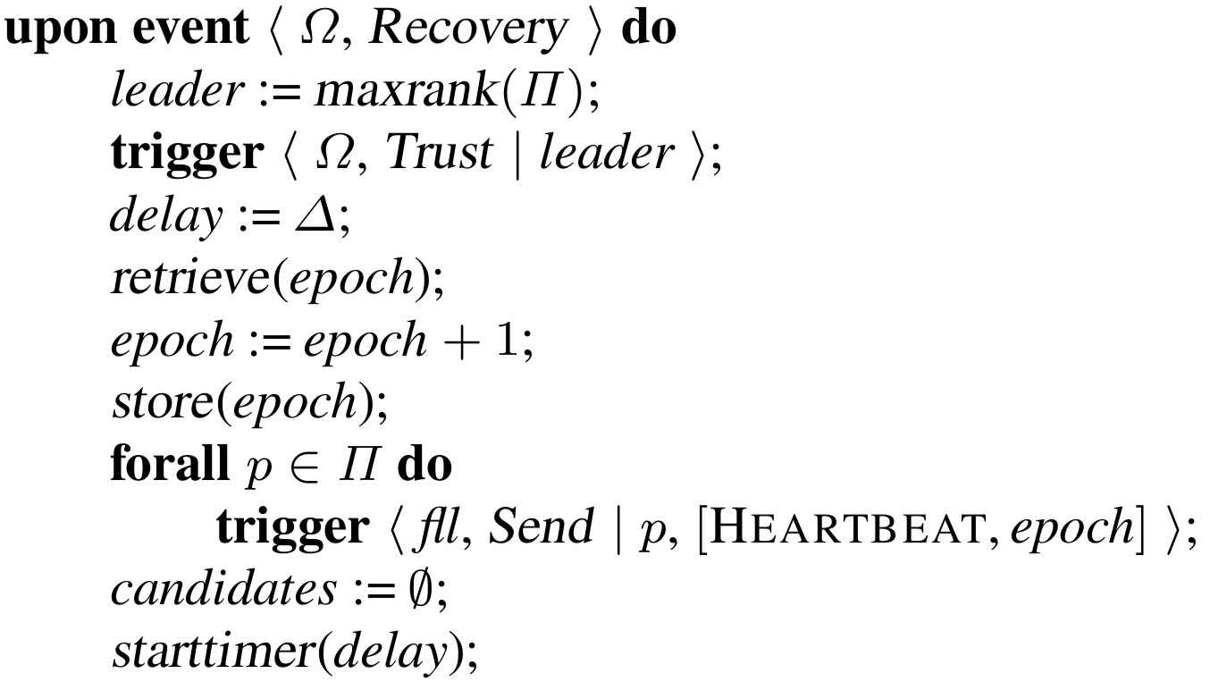
Notes:
ELD1: Eventual accuracy: There is a time after which every correct process trusts some correct process.
ELD2: Eventual agreement: There is a time after which no two correct processes trust different correct processes.

Slide 110
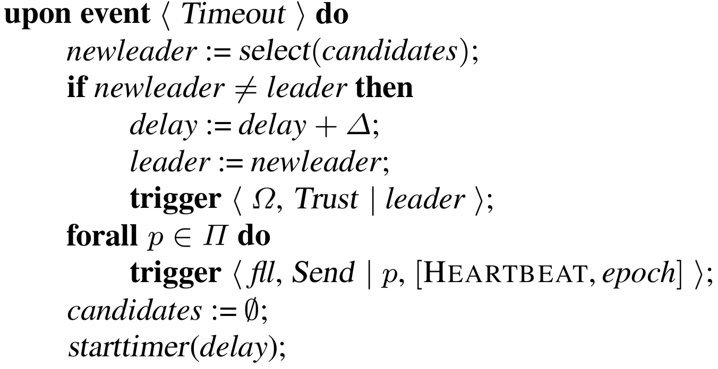
Notes:
ELD1: Eventual accuracy: There is a time after which every correct process trusts some correct process.
ELD2: Eventual agreement: There is a time after which no two correct processes trust different correct processes.

Slide 111
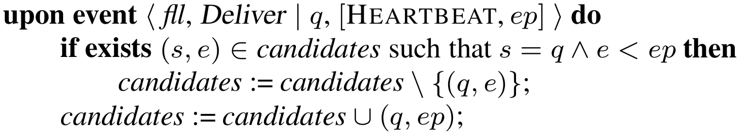
Notes:
ELD1: Eventual accuracy: There is a time after which every correct process trusts some correct process.
ELD2: Eventual agreement: There is a time after which no two correct processes trust different correct processes.

Slide 112
byzantine leader election
One cannot rely on the timeliness of simple responses for detecting arbitrary faults
Every elected leader gets a chance to perform well
Allow application to complain about a process
If more than f (number of processes that can fail and all still be OK) processes complain, consider it faulty
Why f?

Slide 113
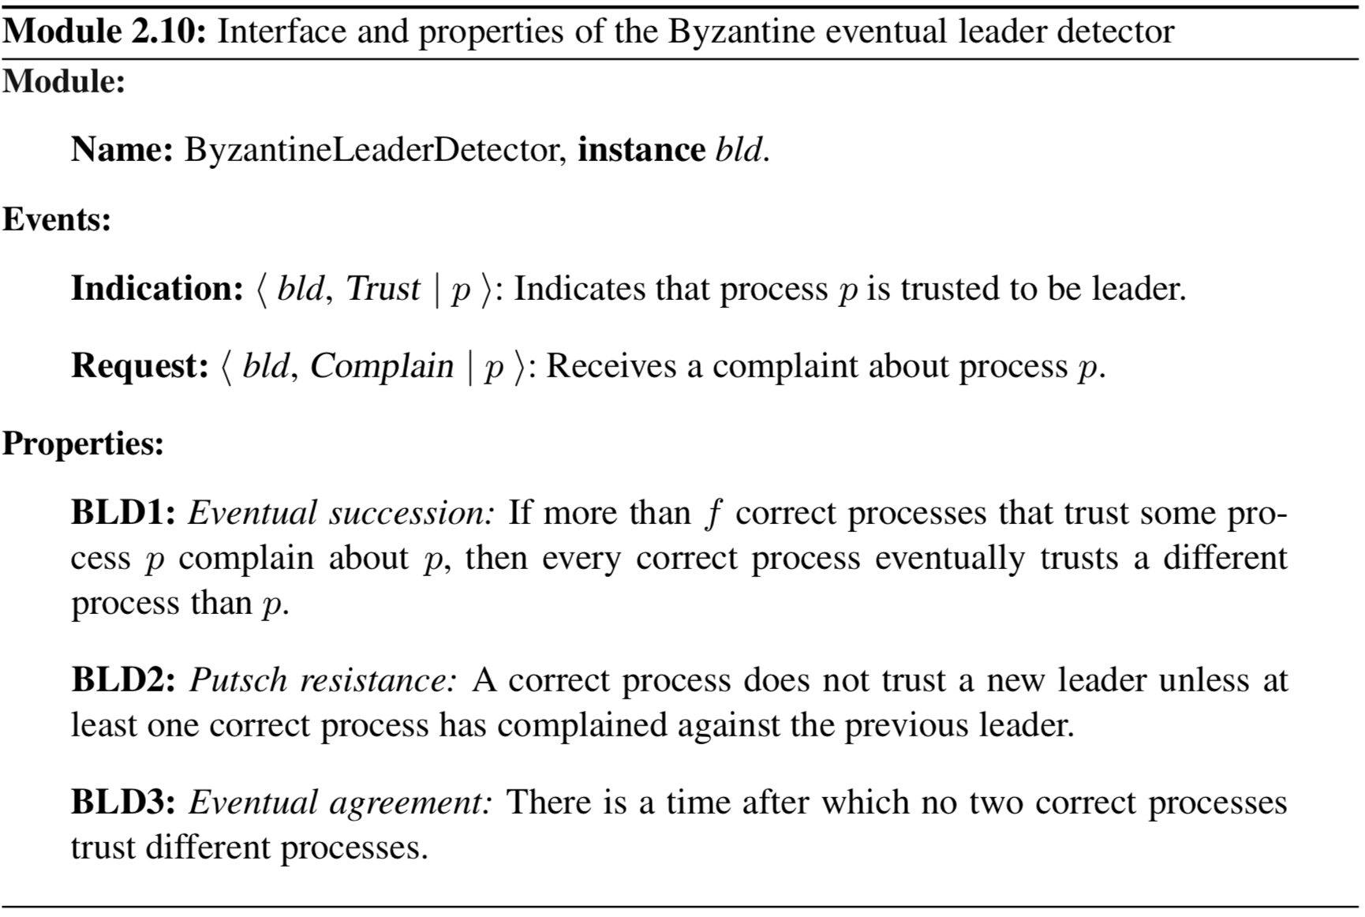
Byzantine leader election

Slide 114
byzantine leader election algroithm
Assumes N > 3f
The leader of a round r is simply the process p whose rank is r mod N

Slide 115
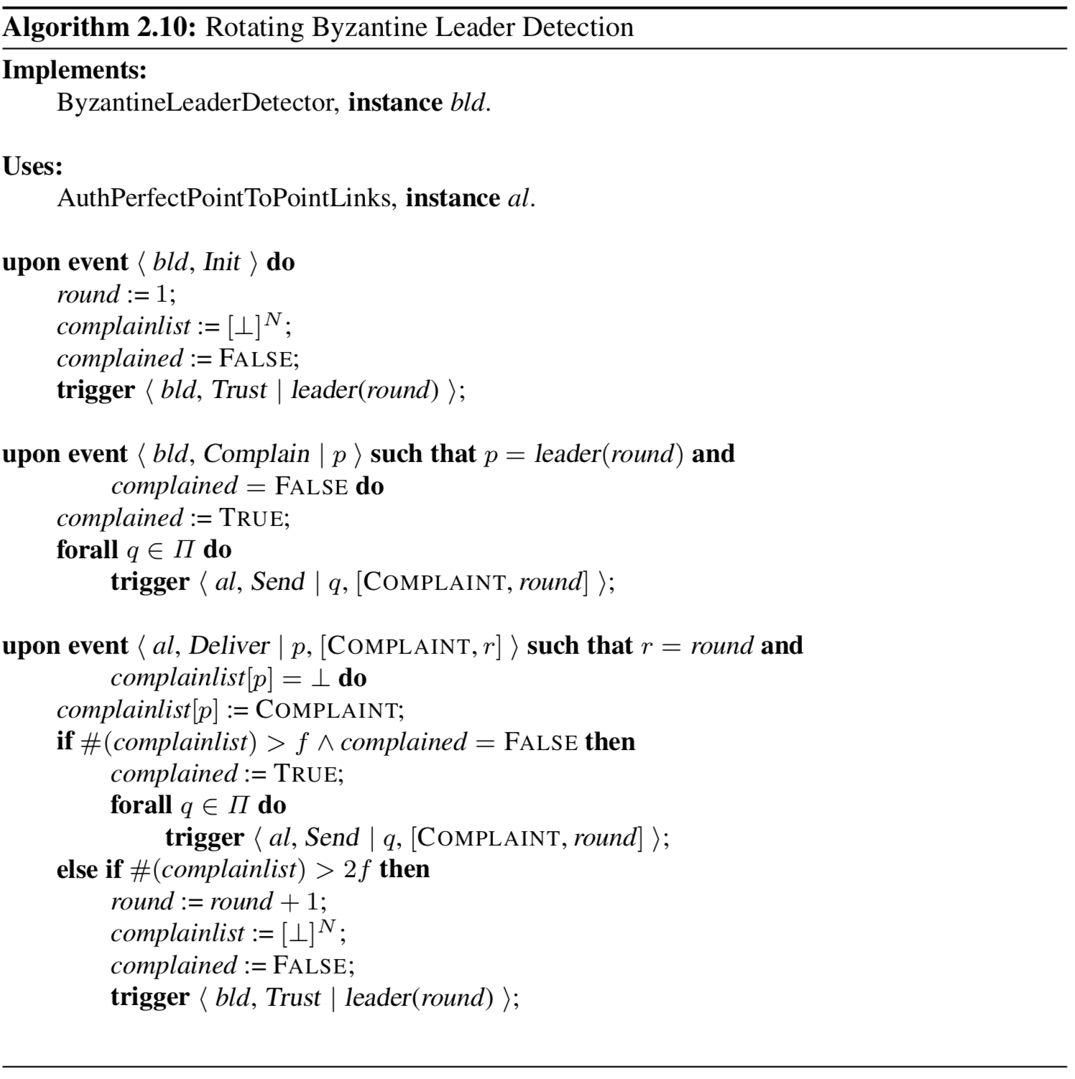
Notes:
BLD1: Eventual succession: If more than f correct processes that trust some pro- cess p complain about p, then every correct process eventually trusts a different process than p.
BLD2: Putsch resistance: A correct process does not trust a new leader unless at least one correct process has complained against the previous leader.
BLD3: Eventual agreement: There is a time after which no two correct processes trust different processes.

Slide 116
distributed system models
A combination of
a process abstraction
a link abstraction
possibly a failure-detector abstraction
Defines a distributed system model

Slide 117
models from combinations
Fail-stop
crash-stop process abstraction
links are perfect
assume the existence of a perfect failure detector (P)
Fail-noisy
crash-stop process abstraction
links are perfect
assume the existence of the eventually perfect failure detector ($⋄$P)

Slide 118
models from combinations
Fail-silent
rash-stop process abstraction
links are perfect
NO failure detection or leader election
Fail-recovery
crash-recovery process abstraction
links are stubborn
may rely on the eventual leader detector (Ω)

Slide 119
models from combinations
Fail-arbitrary
most general of the models
uses the fail-arbitrary (or Byzantine) process abstraction
links are authenticated perfect links
could also be called the fail-silent-arbitrary model
Randomized
of a different nature than the rest
not necessarily deterministic
processes may use a random source to choose among several steps to execute
implement a given abstraction with some (hopefully high) probability

Slide 120
from the models
Some things we look at only work in some of these models
Solutions will be given in as many different models as is reasonable

Slide 121
quorums
A quorum is a set of processes with special properties
any majority of processes, i.e., any set of more than $\frac{N}{2}$ processes (a set of $⌈\frac{(N+1)}{2}⌉$ or more processes)
Several algorithms rely on quorums and exploit the fact that every two quorums overlap in at least one process
even if f < $\frac{N}{2}$ processes fail by crashing, there is always at least one quorum of non-crashed processes in such systems

Slide 122
byzantine quorums
A Byzantine quorum tolerating f faults is a set of more than $\frac{(N+f)}{2}$ processes (any set of $⌈\frac{(N+f+1)}{2}⌉$ or more processes)
algorithms tolerating Byzantine faults usually require that only f < $\frac{N}{3}$ processes may fail
or equivalently when N > 3f

Slide 123
measuring performance
We typically analyze cost of algorithm using:
the number of messages required to terminate an operation of the abstraction
the number of communication steps required to terminate such an operation
for some, its total communication size
for fail-recovery, the number of accesses to stable storage
We count the messages, communication steps, and disk accesses in specific executions of the algorithm
Algorithms that have their performance go proportionally down when the number of failures increases are sometimes called gracefully degrading algorithms

Slide 124
Incentive opportunities
End to End Arguments in System Design. Saltzer, Reed, Clark TOCS 1990.
Fundamentals of Fault-tolerant Distributed Computing in Asynchronous Environments. Felix C. Gartner, ACM Computing Surveys 31(1):1—26, 1999.

Slide 125
problems for chapter test
What is the crash-stop failure model?
What are the 3 properties of perfect links?
Algorithm 2.2 “Eliminate Duplicates”
What are the three conditions of the “happens-before” relation?
Discuss Synchronous vs. Asynchronous vs. Partially Synchronous
What are the two properties of the Perfect Failure Detector?
Algorithm 2.5 “Exclude on Timeout”
Describe in one or two sentences the Fail-stop model
Exercises 2.3, 2.6, 2.7

